Slide 1
Car rental system
You're better off driving our way

Slide 2
Group details
Group No : 13
Members : B32 Mansuri Mohammed Sufyan
B43 Patel Harshil
B55 Shahu Dipak Kumar
Guide : Het Rachh

Slide 3
definition
Car rental system allows individuals to book a self-drive rental car by the day, week, or month. It seamlessly integrates into any platform as it is a web app. Our service enables users to rent cars for traveling in the city or outstation.

Slide 4
Existing System
Currently users book car using the traditional manual system of vehicle reservation through calling or visiting at store
Need For the New System
To eliminates the risk of erroneous booking and reduce overall lead time online booking system needed.

Slide 5
Objectives of the New System
The objective of the project is to automate vehicle rental reservation so that the customers do not need to call and spend unnecessary time to reserve a vehicle. And for the company process become easier to manage bookings and cars on system rather than manual.
Customer is only needed to provide Aadhar number instead of submitting identity document.

Slide 6
Problem Statement
Customer inquire the company to rent a car. Admin validates the request and ask for security proof. Company asks customer to pay security deposit. After validating the request company can approve or reject car rental request with valid reasons. Then customer is asked to pay booking amount in advance or after the completion of booking. Security proof is returned to the customer after booking period.

Slide 7
Features
Easy Bookings
Testimonials
Quick and secure payment
User management
Fleet Management
Website Analytics
Customer Support

Slide 8
Modules
Customer
Login/Logout.
View fleet.
View their transaction history.
View & manage their account details.
View & give testimonials.
Request inquiry.

Slide 9
Modules
Admin
Login/Logout.
Admin can manage fleet.
Manage bookings.
Manage users.
View testimonials.
Manage inquires

Slide 10
Modules
Visitor
Register.
View fleet.
View Testimonials.
Request inquiry.

Slide 11
Technologies
Front End : HTML, CSS, JavaScript
Back End : Django ( Python )
Database : MySQL

Slide 12
Assumptions
All group members have required skills.
All of the PC/Laptops are in good conditions.
All needed resources will be available.
Active internet connection is available to all members

Slide 13
Constraints
Project needs to completed in the span of two months.
Group members need to learn Django.
We need to take references from websites as local business can’t be visited due to current ongoing pandemic situation.

Slide 14
Advantages
Automated System
Saves time and cost
The car rental system present instant support to the clients.
The car rental system gives an easy booking facility for the clients.
The receipts can be easily generated from the rental system.
The clients can make advance payment online and bookings for the cars.

Slide 15
Limitations
Internet Connectivity
Limited Pickup & Drop Points
GPS tracking

Slide 16
Requirement determination
The existing system that is manual, customers contact the company for booking. Customers submits identity document and pay security deposit and receipt is given to them for their booking. We decided to use Zoom Car as reference. Then our project team determined the system can be built with fulfilled requirements using Django framework.

Slide 17
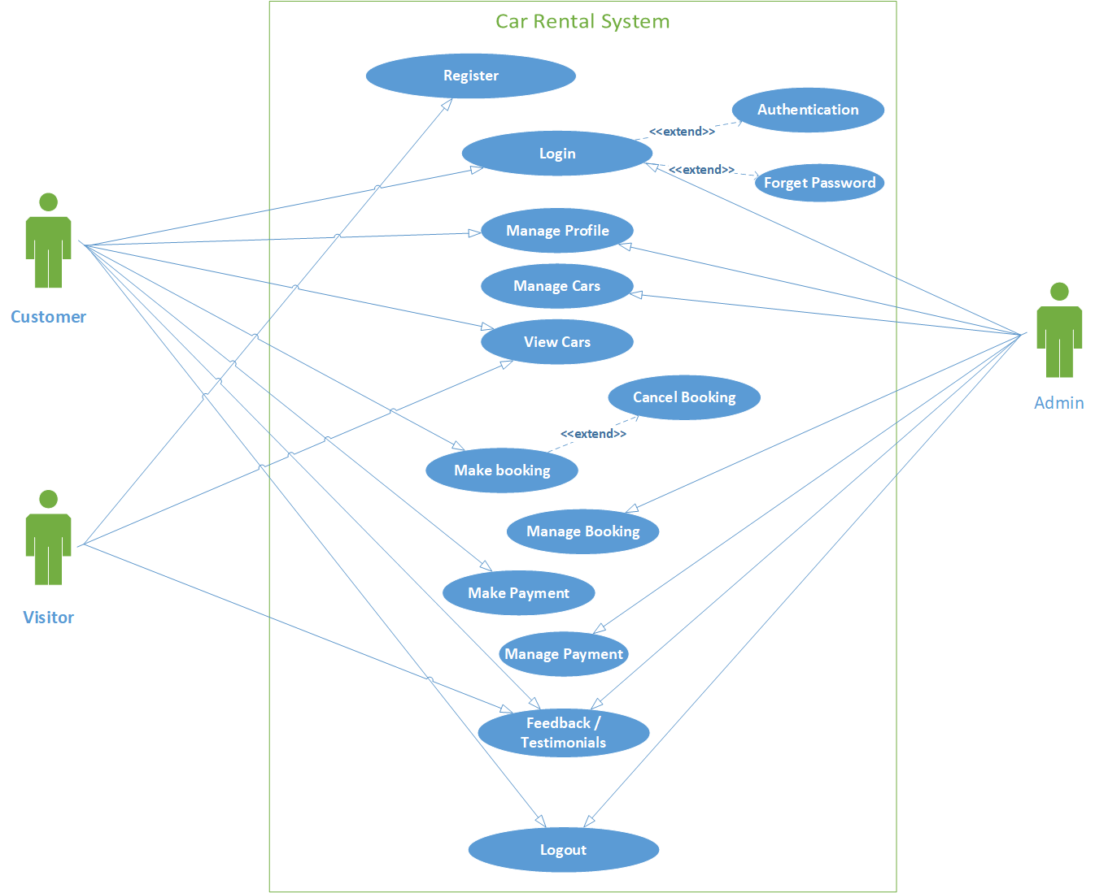
USE CASE

Slide 18
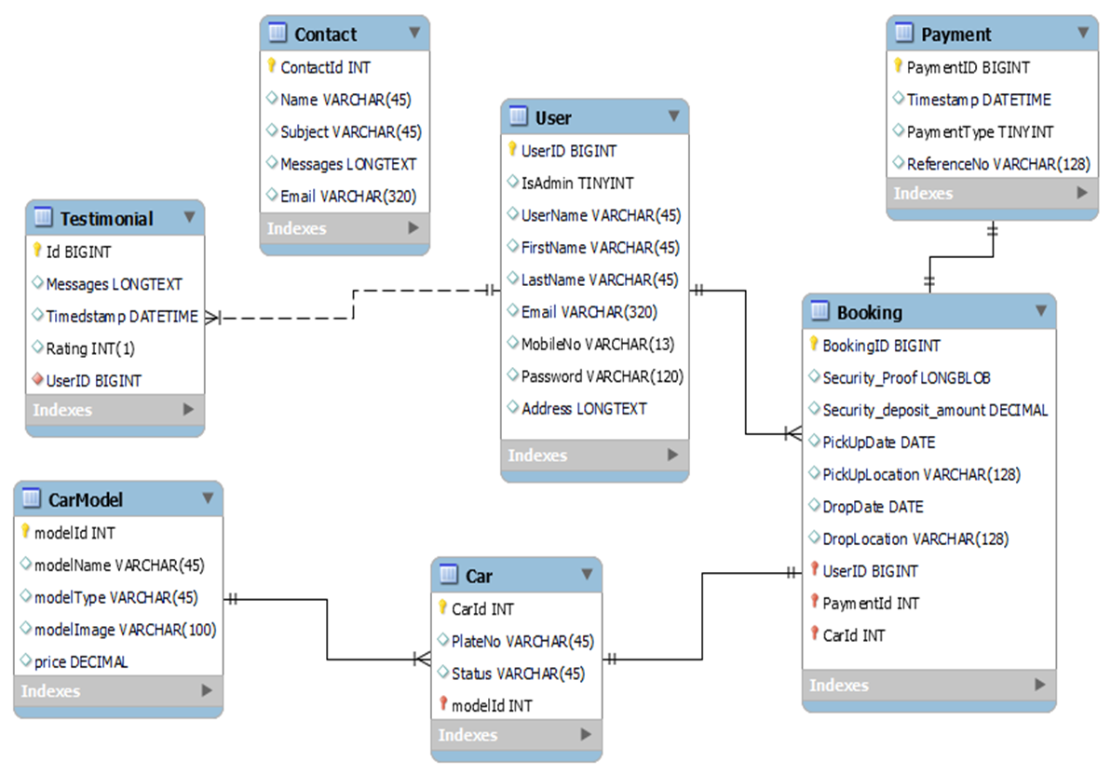
ER DIAGRAM

Slide 19
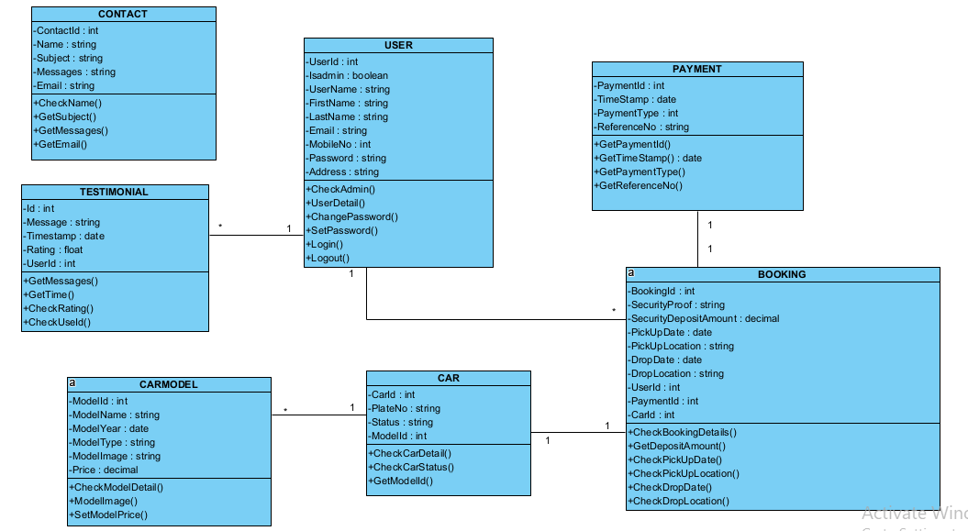
CLASS DIAGRAM

Slide 20
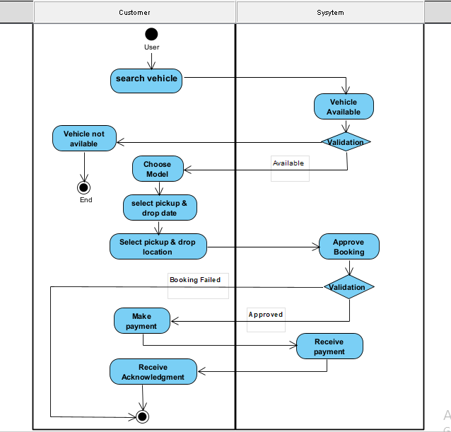
Activity Diagram

Slide 21
SEquENCE DIAGRAM

Slide 22
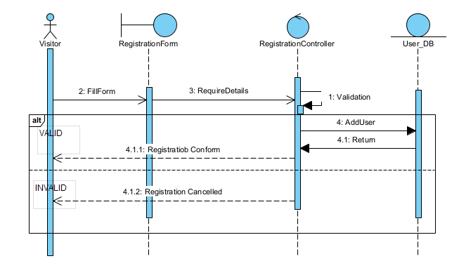
REGISTRATION

Slide 23
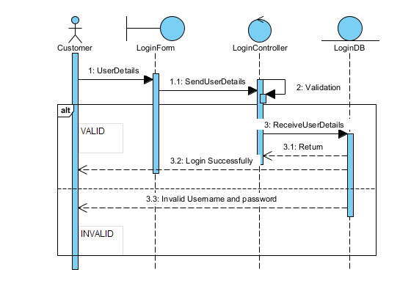
LOGIN

Slide 24
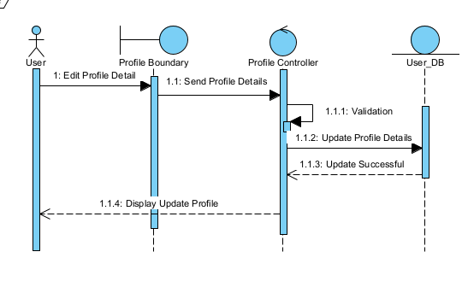
MANAGE PROFILE

Slide 25
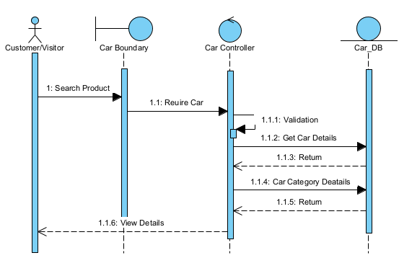
View car

Slide 26
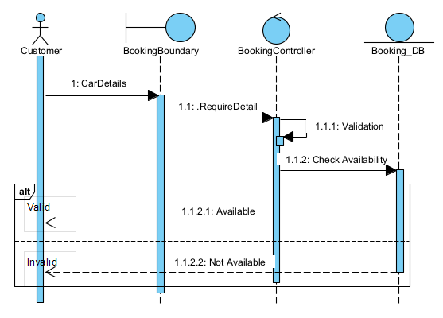
Booking

Slide 27
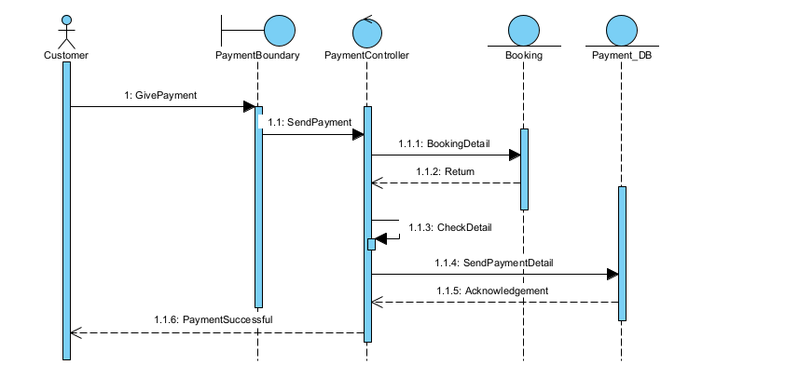
make PAYMENT

Slide 28
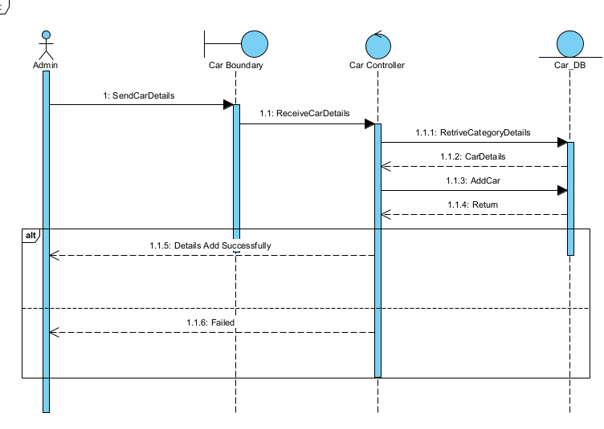
MANAGE CAR

Slide 29
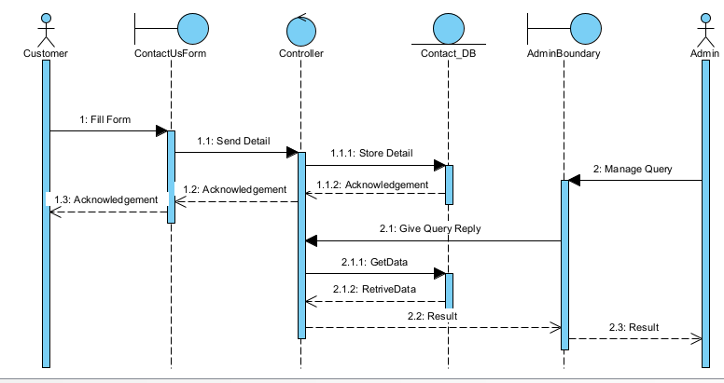
TESTIMONIAL

Slide 30
Data dictionary

Slide 31
USER
Column | Type | Constraints | Desciption | Sample Data
UserId | BIGINT(15) | PIMARY KEY | Id of user | 1
IsAdmin | TINYINT(1) | NOT NULL | Role of user 0: Admin, 1: Not Admin | 1
UserName | VARCHAR(45) | NOT NULL, UNIQUE | Website Name of user | dipakShahu
FirstName | VARCHAR(45) | - | Name of user | Dipak
LastName | VARCHAR(45) | - | Last name of user | Shahu
Email | VARCHAR(320) | NOT NULL, UNIQUE | Email of user | ds@gmail.com
MobileNo | VARCHAR(13) | UNIQUE | Mobile no of user | +917926199912
Password | VARCHAR(120) | NOT NULL | Password of user account | pbkdf2_sha256$260000…
Address | LONGTEXT | - | Address of user | B/20, Gota, Ahmedabad, Gujarat

Slide 32
BOOKING
Column | Type | Constraints | Desciption | Sample Data
BookingId | BIGINT(15) | PRIMARY KEY | Id of Booking | 1
SecurityProof | LONGBLOB | NOT NULL | Id proof of user | booking-security Proof.bin
SecurityDepositAmount | DECIMAL(7,2) | NOT NULL | Deposit amount | 2499.00
PickUpDate | DATE | NOT NULL | Car Pick up date | 2021-07-13
PickUpLocation | VARCHAR(128) | NOT NULL | Pick up location | Ahmedabad Railway-station
DropDate | DATE | NOT NULL | Car Drop date | 2021-07-18
DropLocation | VARCHAR(128) | NOT NULL | Drop location | Ahmedabad Railway-station
UserId | BIGINT(15) | FOREIGN KEY | Reference of user table | 1
PaymentId | BIGINT(15) | FOREIGN KEY | Reference of user payment | 1
CarId | INT(11) | FOREIGN KEY | Id of car | 1

Slide 33
Car
Column | Type | Constraints | Desciption | Sample Data
CarId | INT (11) | PRIMARY KEY | Id of car | 1
PlateNo | VARCHAR(10) | NOT NULL | Plateno of car | GJ01VH1234
Status | TINYINT(1) | NOT NULL | Status of car 0: Available, 1: Booked, 2: Maintenance | 0
ModelId | INT(11) | FOREIGN KEY | Reference of model table | 1
CAR MODEL
Column | Type | Constraints | Desciption | Sample Data
ModelId | INT(11) | PRIMARY KEY | Id of model | 1
ModelName | VARCHAR(45) | NOT NULL | Name of model | Hundai i10
ModelType | VARCHAR(45) | NOT NULL | Modeltype of car | Hatchback
ModelImage | VARCHAR(100) | NOT NULL | Image of car | media/blog-4-720x480_U51gd2E.jpg
Price | DECIMAL(7,2) | NOT NULL | Price of car | 1350.00

Slide 34
Testimonial
Column | Type | Constraints | Desciption | Sample Data
TestimonanialId | BIGINT(15) | PRIMARY KEY | Id of testimonial | 1
Message | LONGTEXT | NOT NULL | Messages of user | Hello World
Timestamp | DATETIME | NOT NULL | Date and time of user | 2021-07-09 16:26:42.210756
Rating | TINYINT(1) | NOT NULL, Rating >= 1 and Rating <= 5 | Rating of user | 5
UserId | BIGINT(15) | FOREIGN KEY | Reference of user table | 1

Slide 35
PAYMENT
Column | Type | Constraints | Desciption | Sample Data
PaymentId | BIGINT(15) | PRIMARY KEY | Id of Payment | 1
Timestamp | DATETIME | NOT NULL | Date and time of user | 2021-07-09 16:26:42.210756
PaymentType | TINYINT(1) | NOT NULL | Type of payment | 1
ReferenceNo | VARCHAR(128) | NOT NULL | Reference number of payment | ipi_1IH5Vo2eZvKYlo2CKPRLvsz3

Slide 36
Contact
Column | Type | Constraints | Desciption | Sample Data
ContactId | INT(15) | PRIMARY KEY | Id of Payment | 1
Name | VARCHAR(45) | NOT NULL | Name of user | Dipak
Subject | VARCHAR(45) | NOT NULL | Subject of contact | Car inquiry
Message | LONGTEXT | NOT NULL | Message fo subject | “Hello world!”
Email | VARCHAR(320) | NOT NULL | Email of user | ds9952@gmail.com

Slide 37
ScreenShots

Slide 38
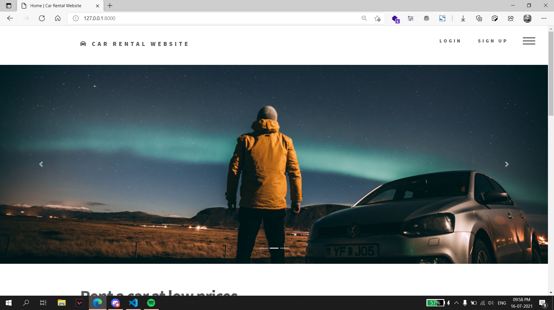
Index Page: This page is shown when someone visits the website.

Slide 39
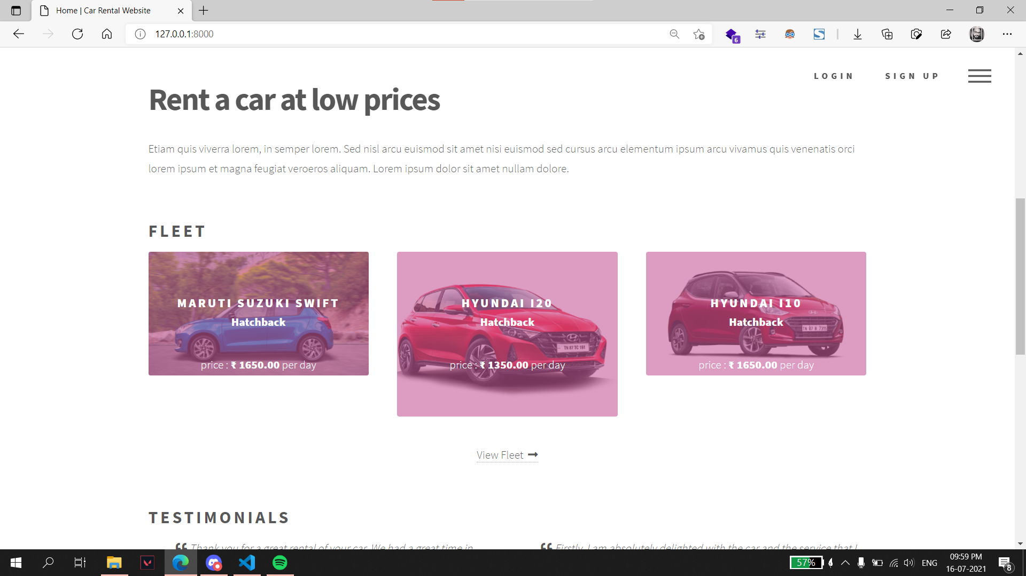
Index Page:

Slide 40
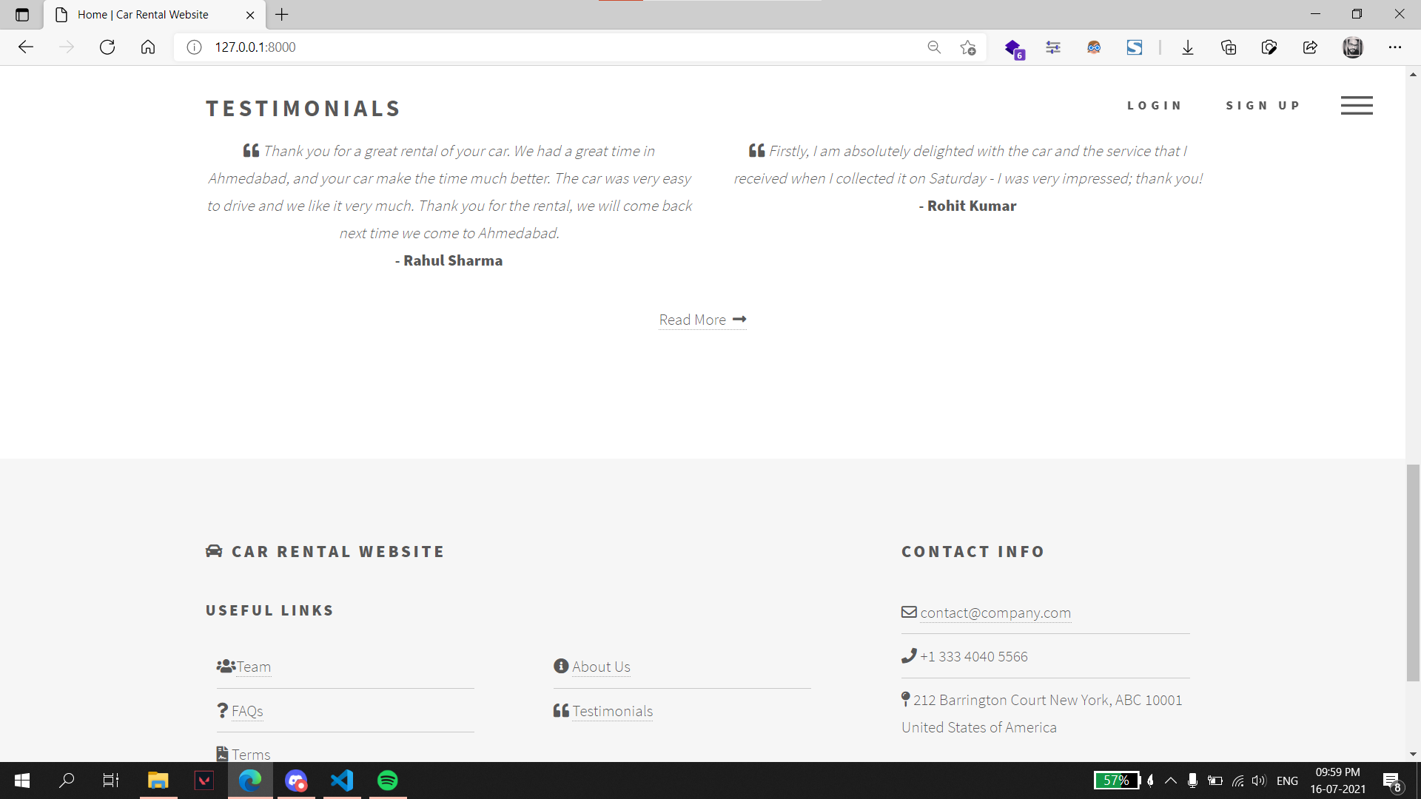
Index Page:

Slide 41
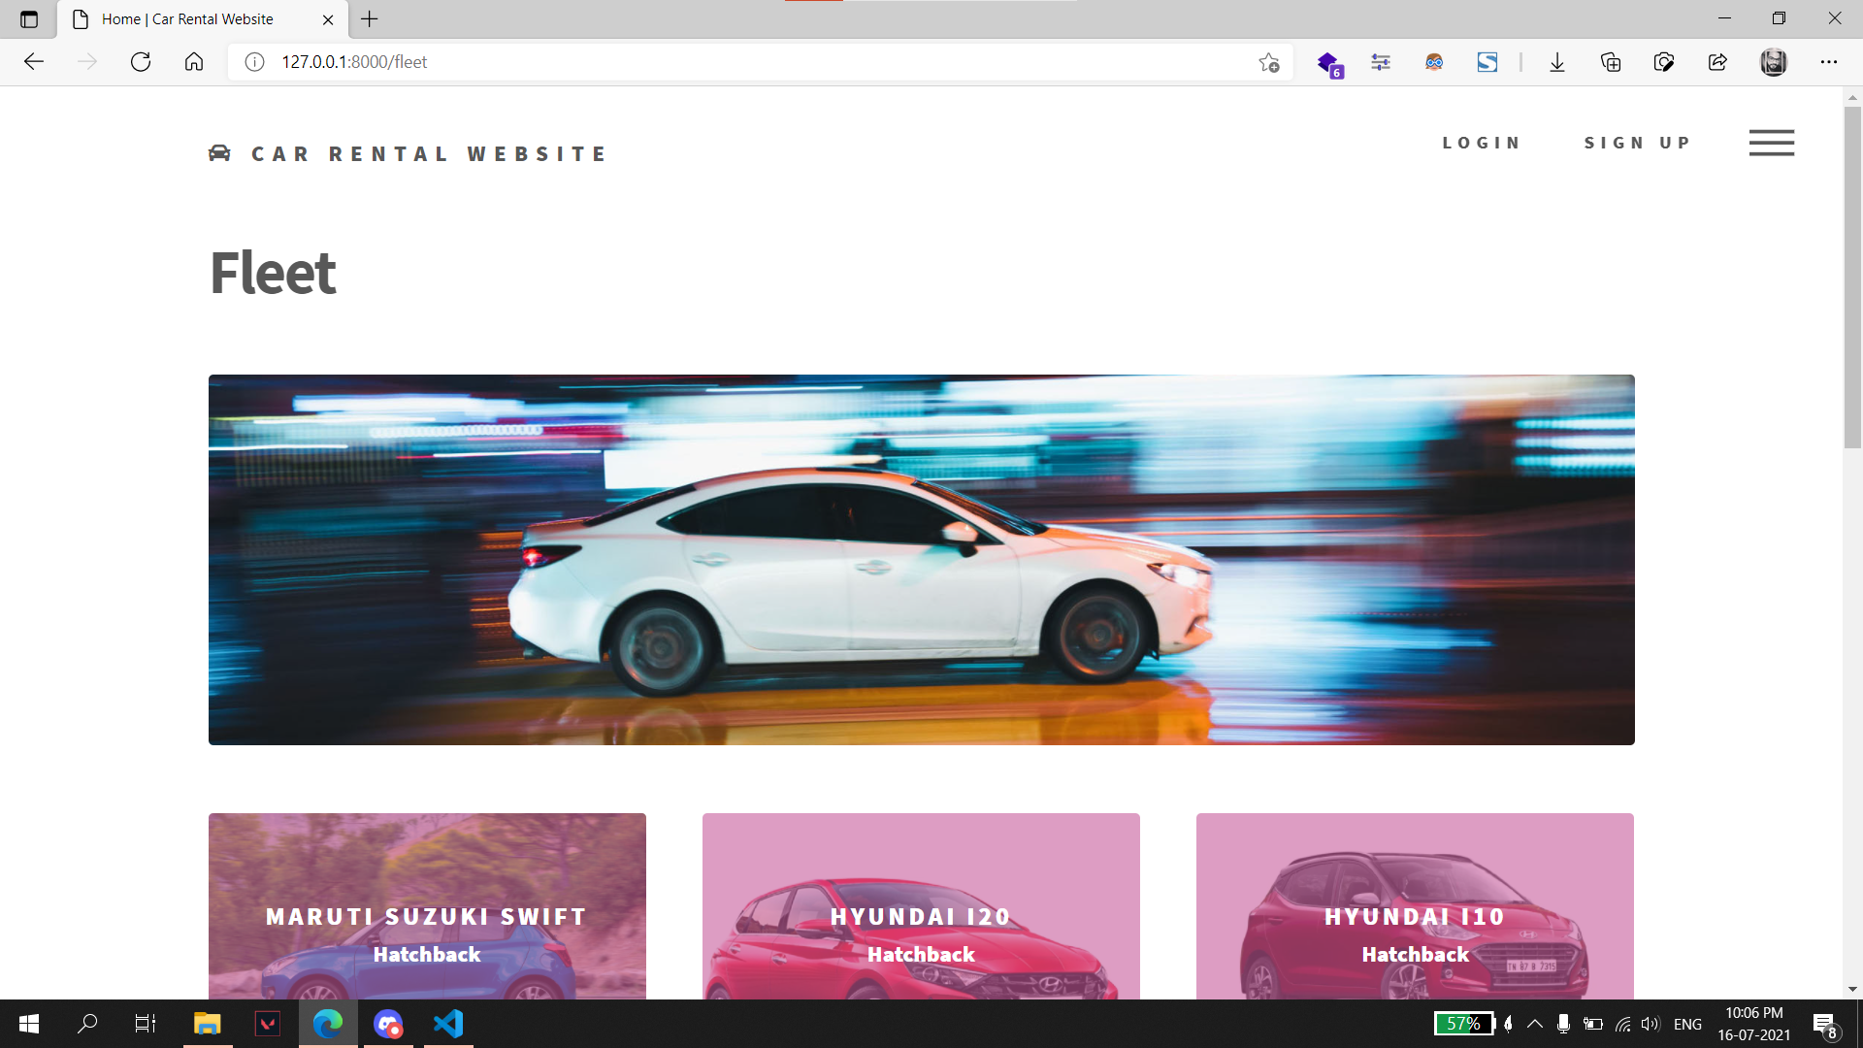
Fleet: Cars are displayed on this page.

Slide 42
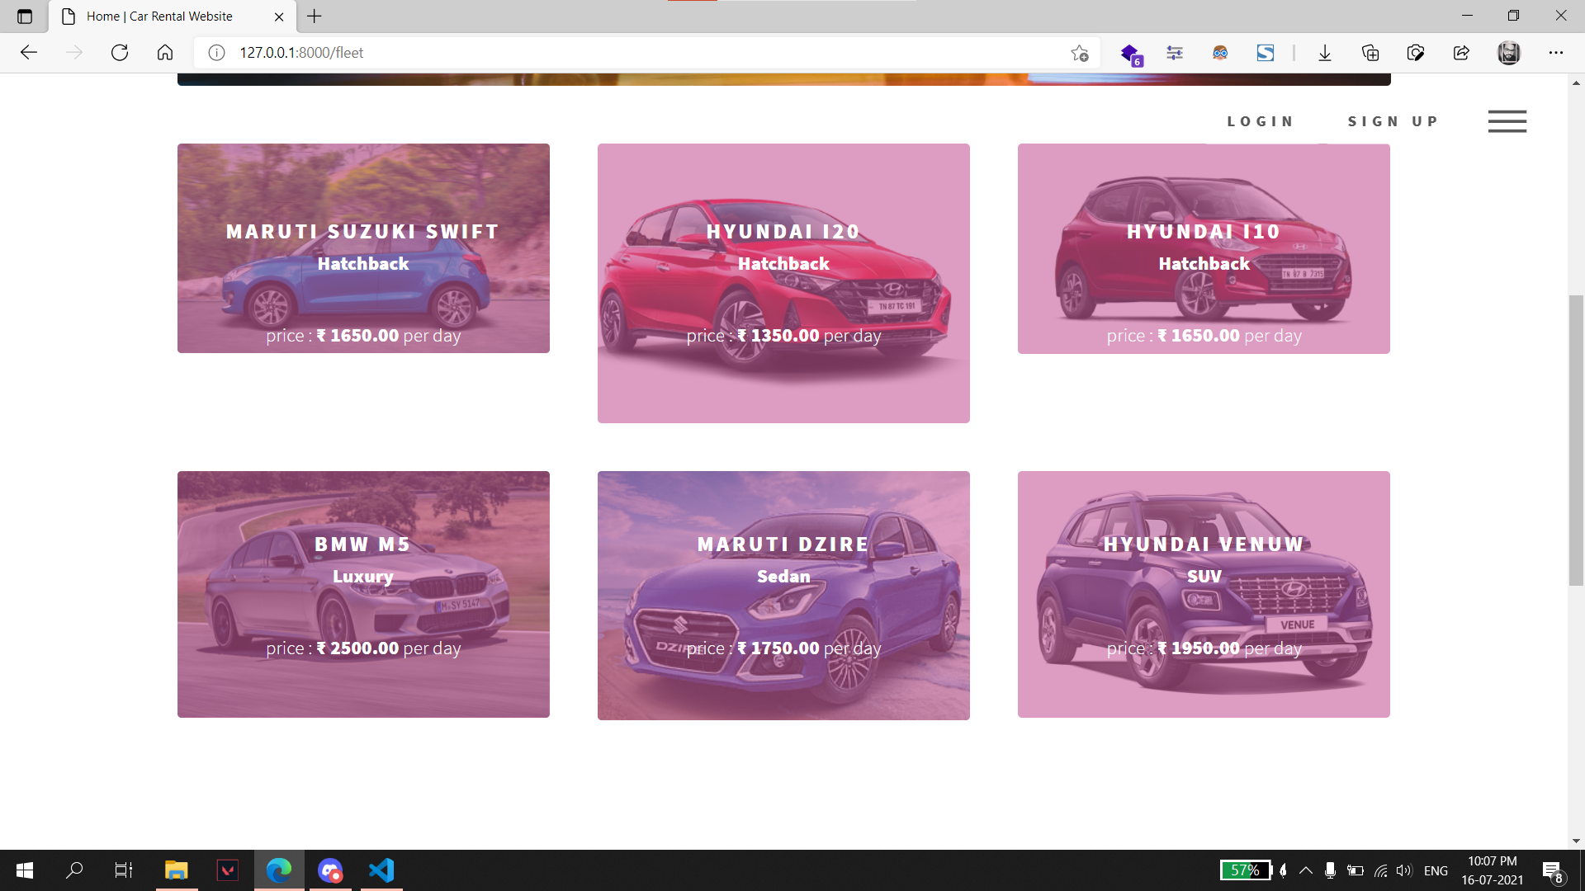
Fleet Page:

Slide 43
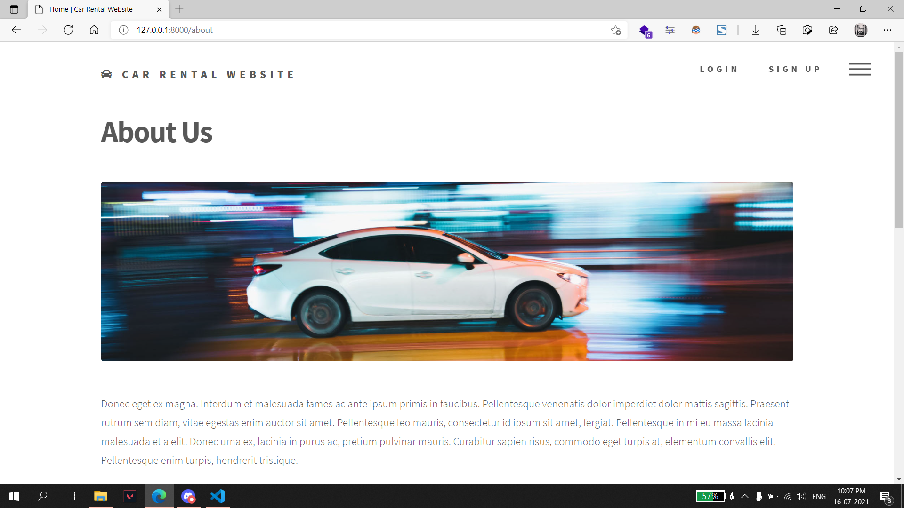
About Us: Information regarding the website is shown on this page.

Slide 44
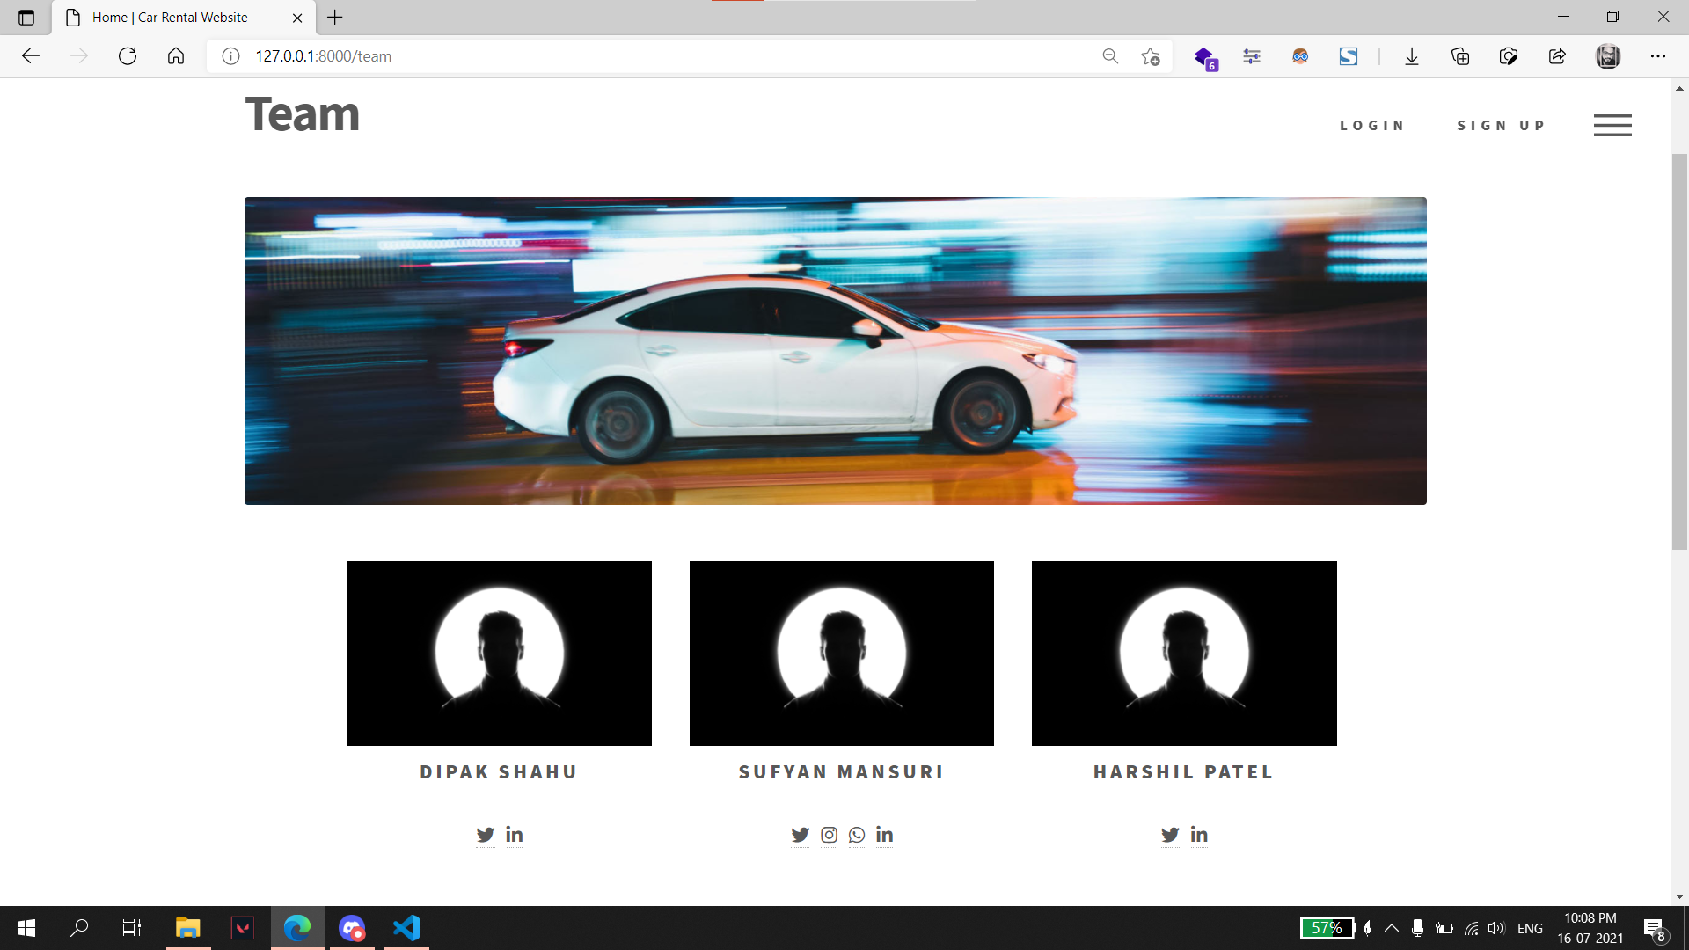
Team: Team member details is shown on team page.

Slide 45
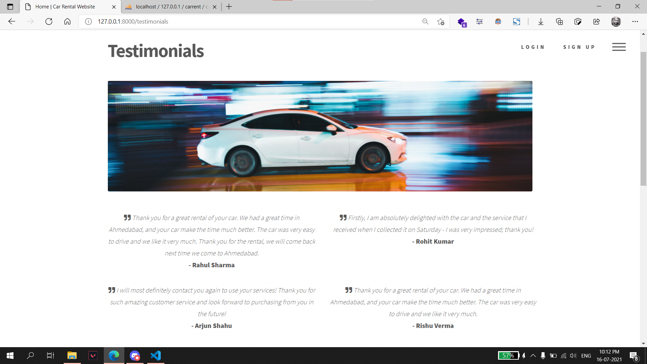
Testimonials: Customer testimonials are displayed on this page.

Slide 46
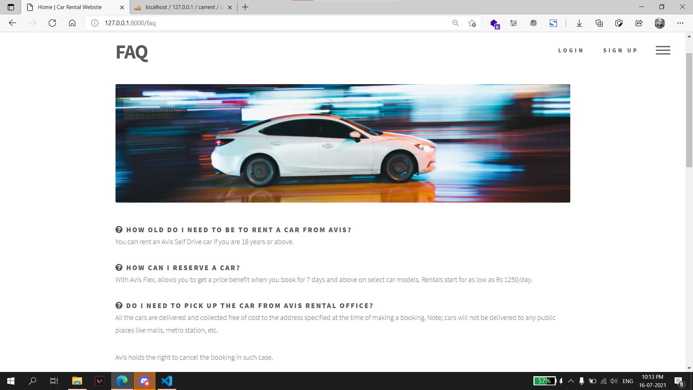
FAQ: Frequently asked questions about the service and their answers are displayed on this page.

Slide 47
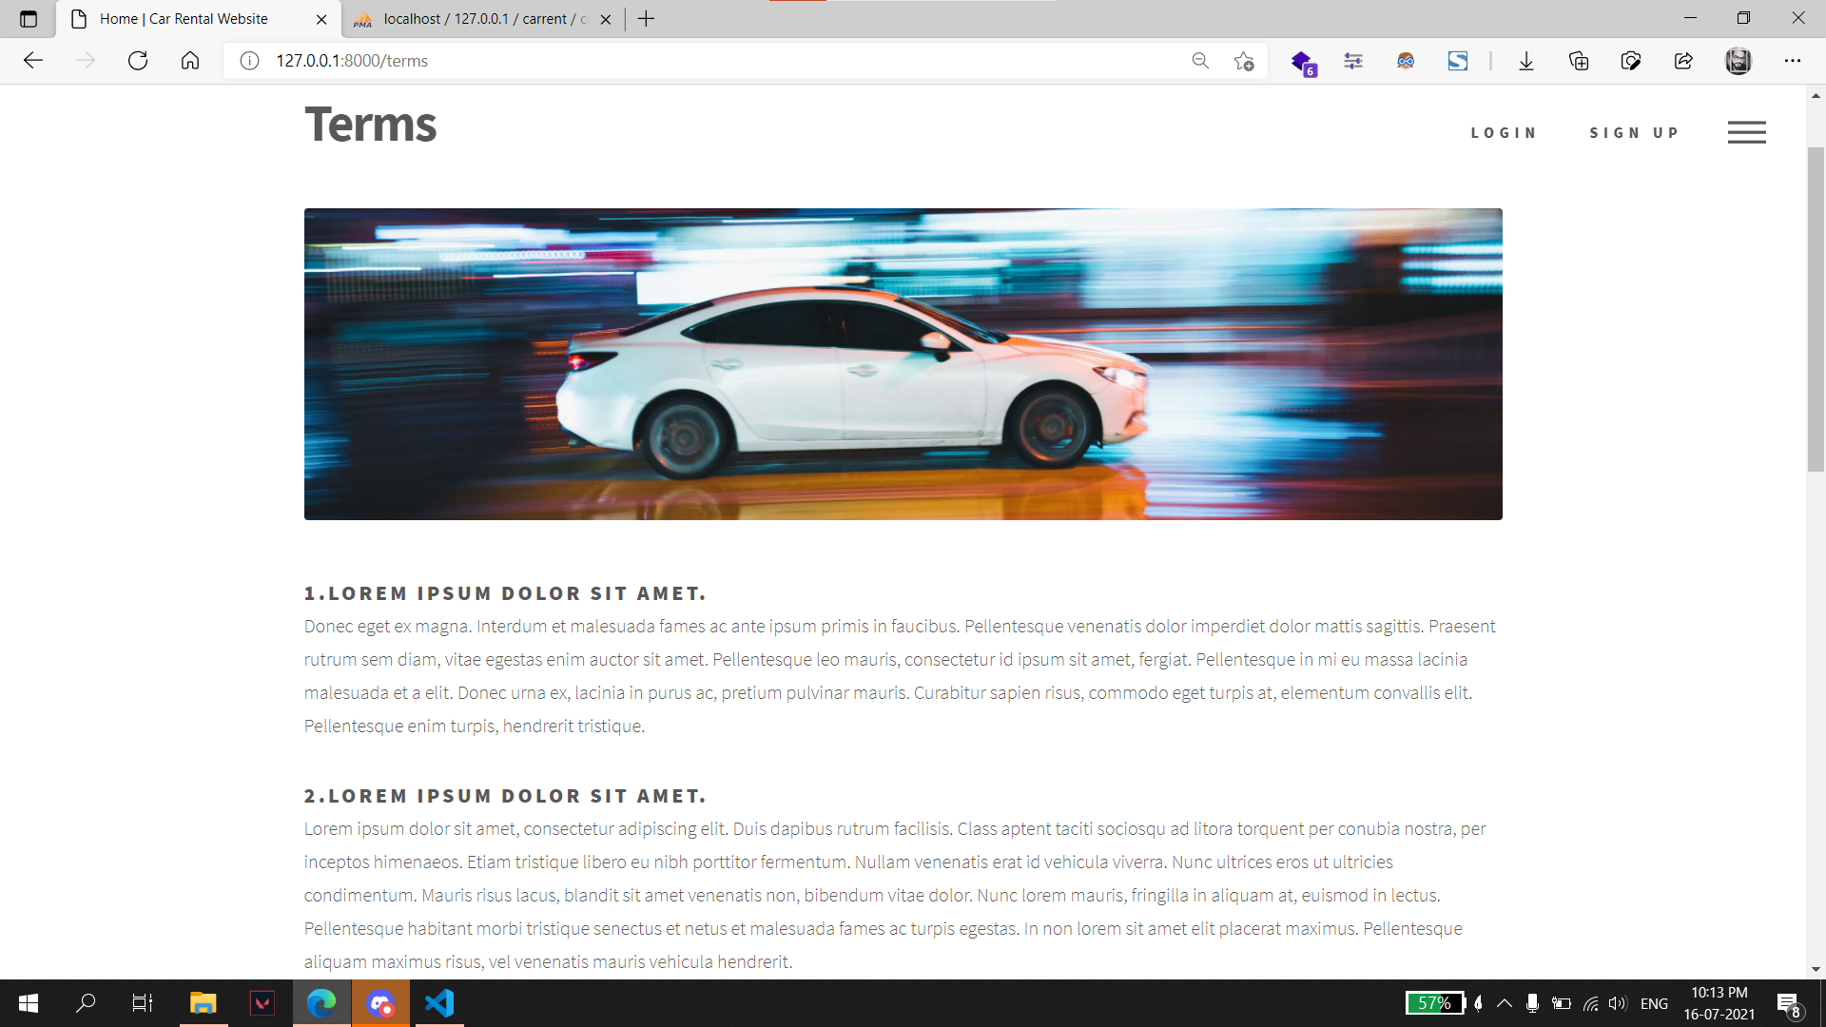
Terms: Terms & Conditions are shown on this page.

Slide 48
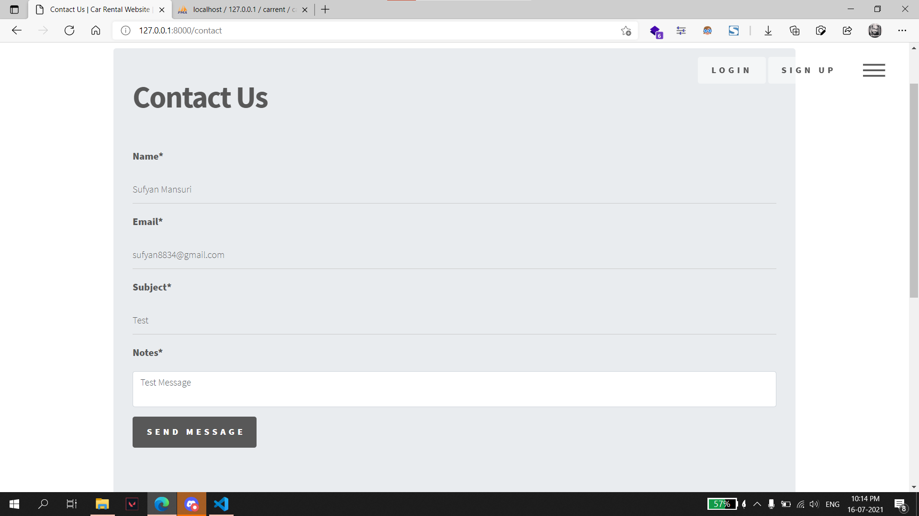
Contact Us: User can submit any queries regarding the service on this page.

Slide 49
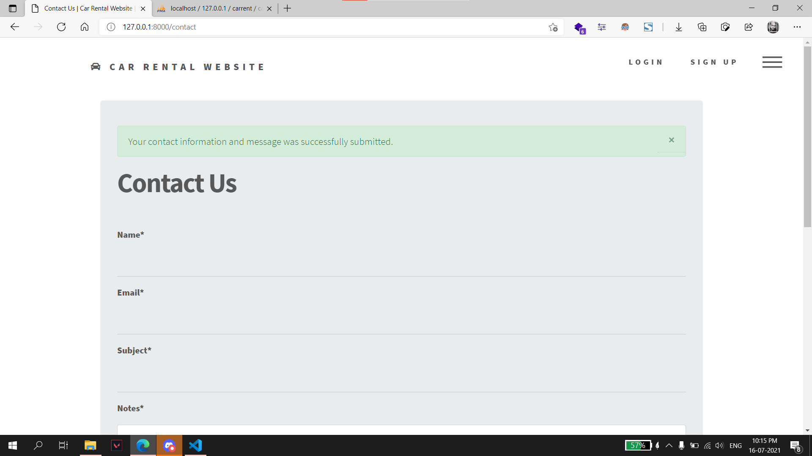
Contact Us: A message is displayed on the page on the page regarding the success or failure of the form submission.

Slide 50
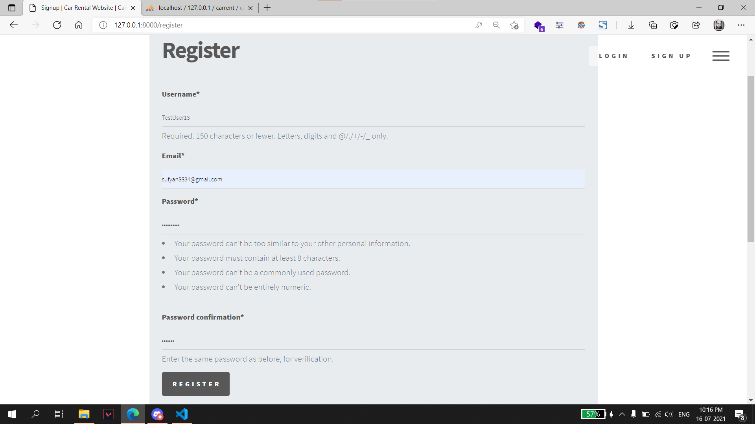
Signup: Users can create a new account on signup page.

Slide 51
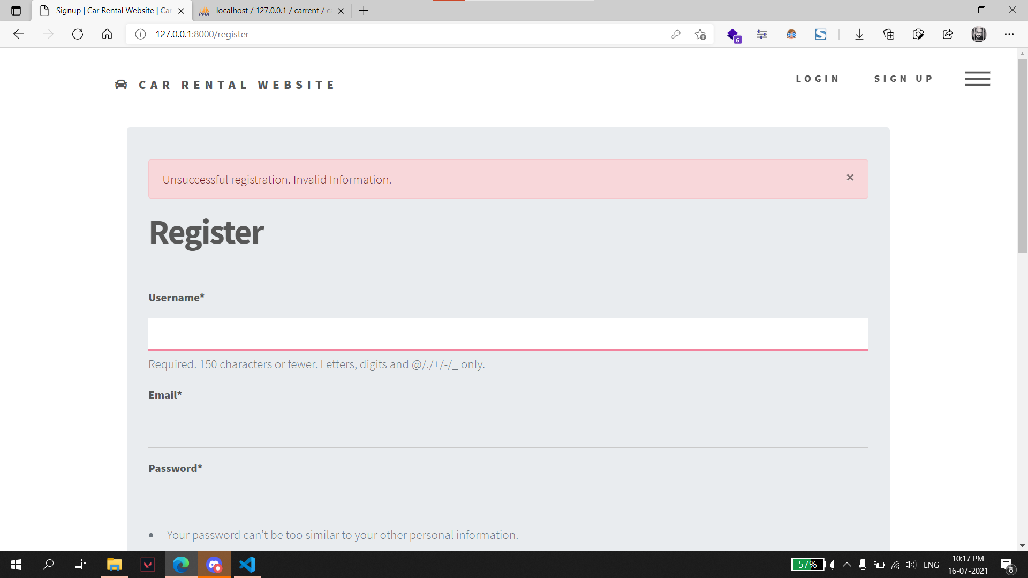
Signup: Signup form is validated and appropriate message is displayed to the user regarding the successful or unsuccessful registration.

Slide 52
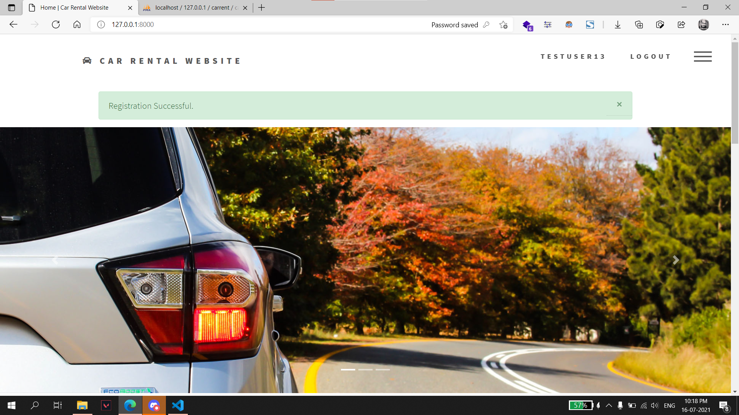
Register: Registration successful message.

Slide 53
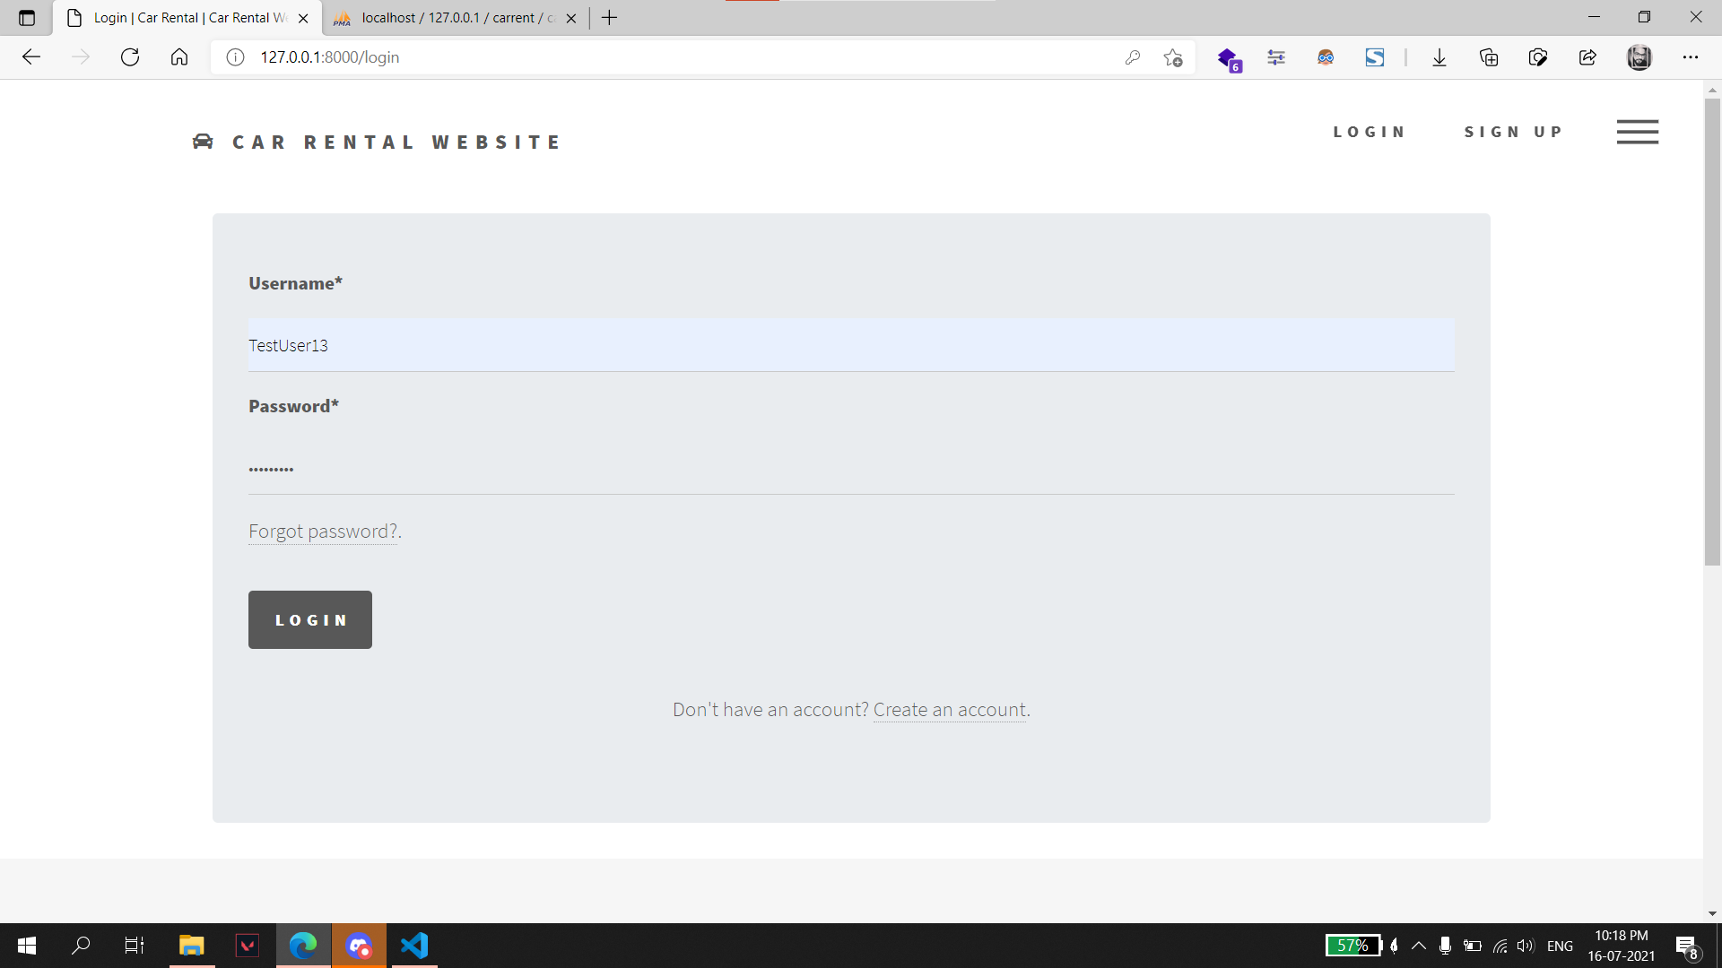
Login: Existing users can login from this page.

Slide 54
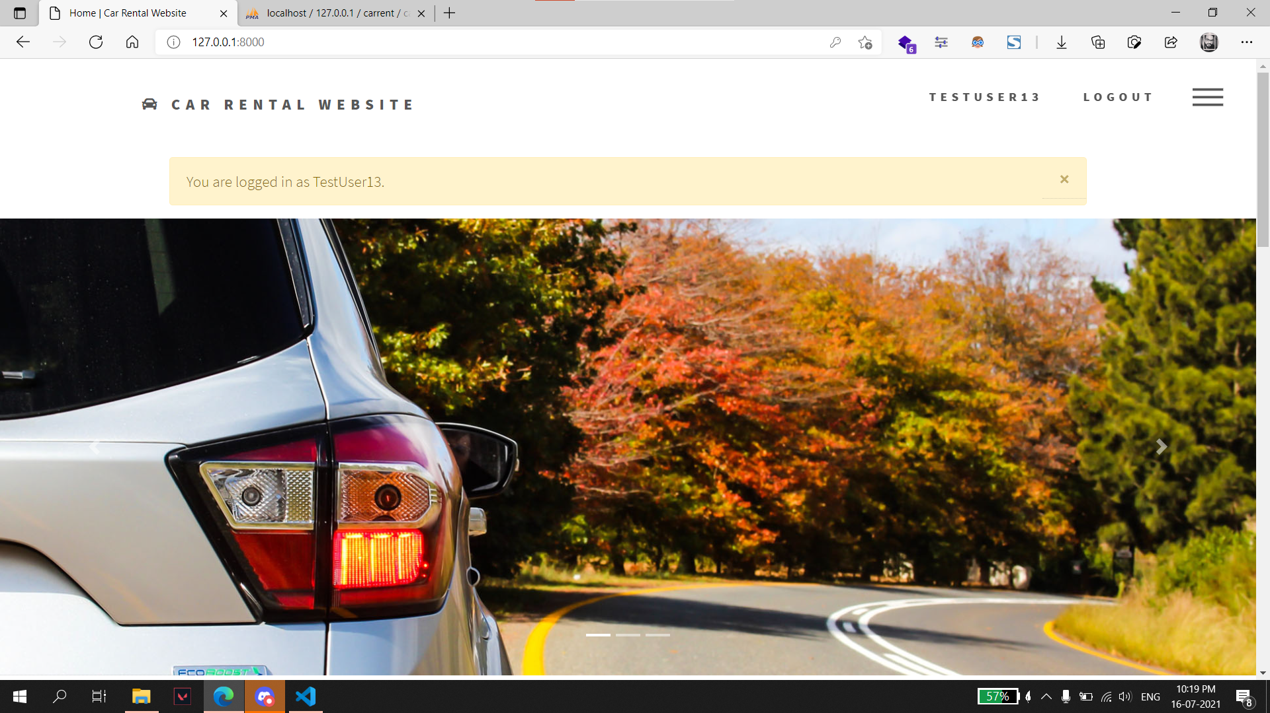
Login Successfully: User is redirected to index page with a message on successful login.

Slide 55
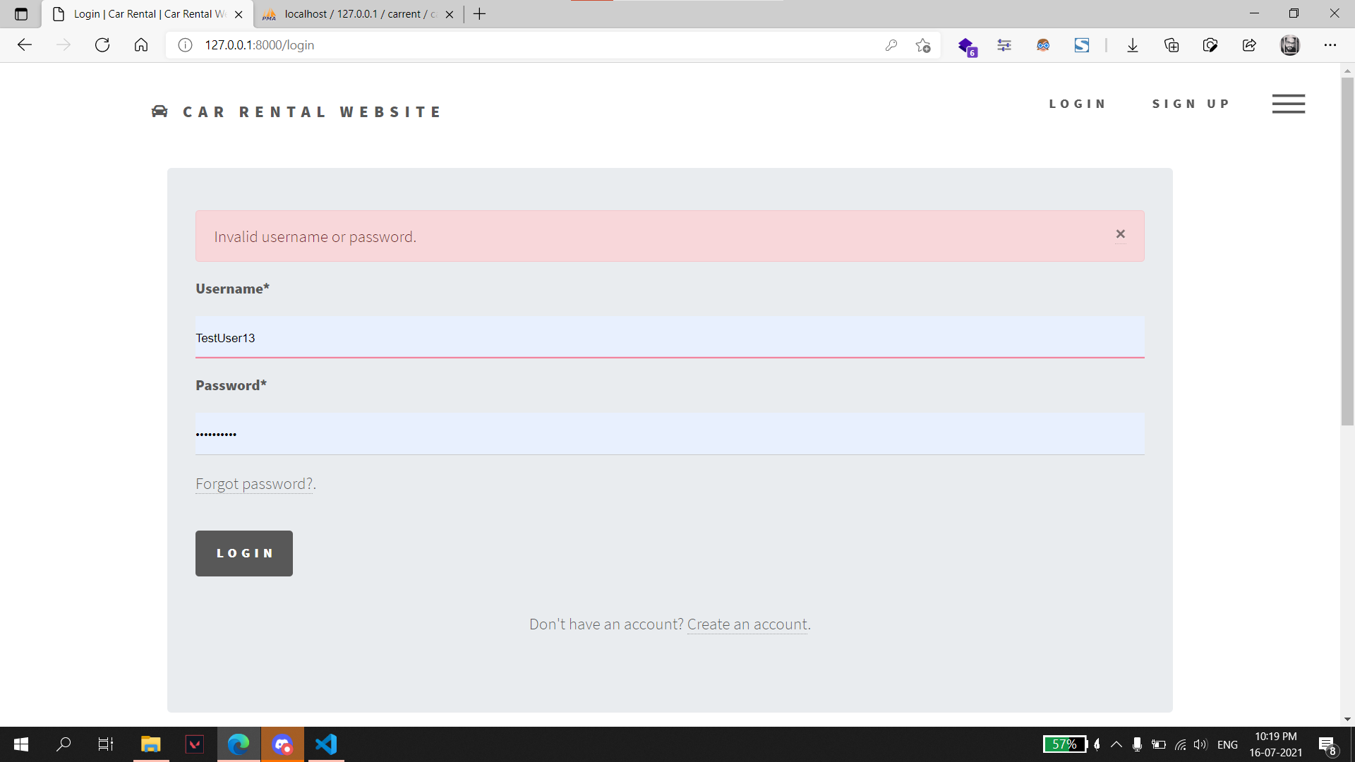
Login: An error message is displayed to the user when invalid information is submitted.

Slide 56
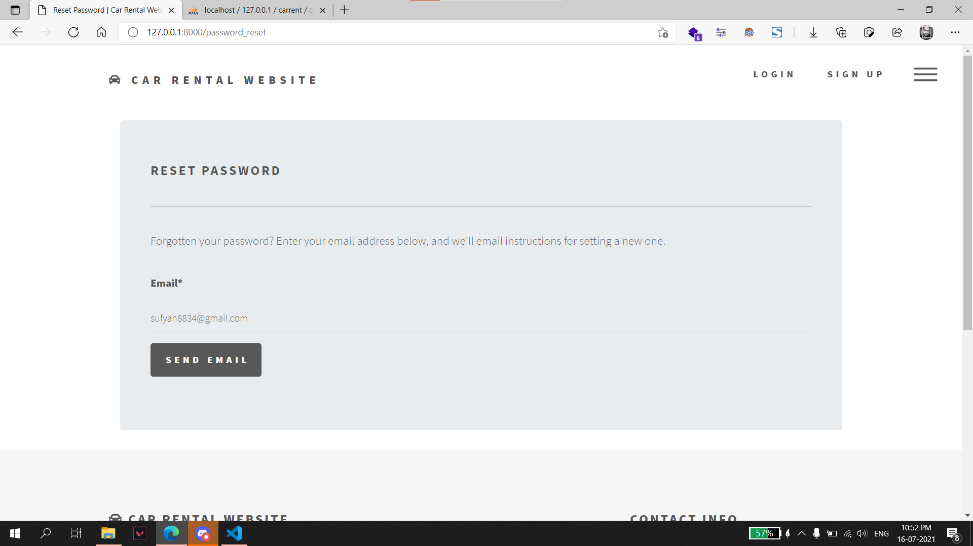
Password Reset: User can reset password from this page.
1. Enter email address associated with the account.

Slide 57
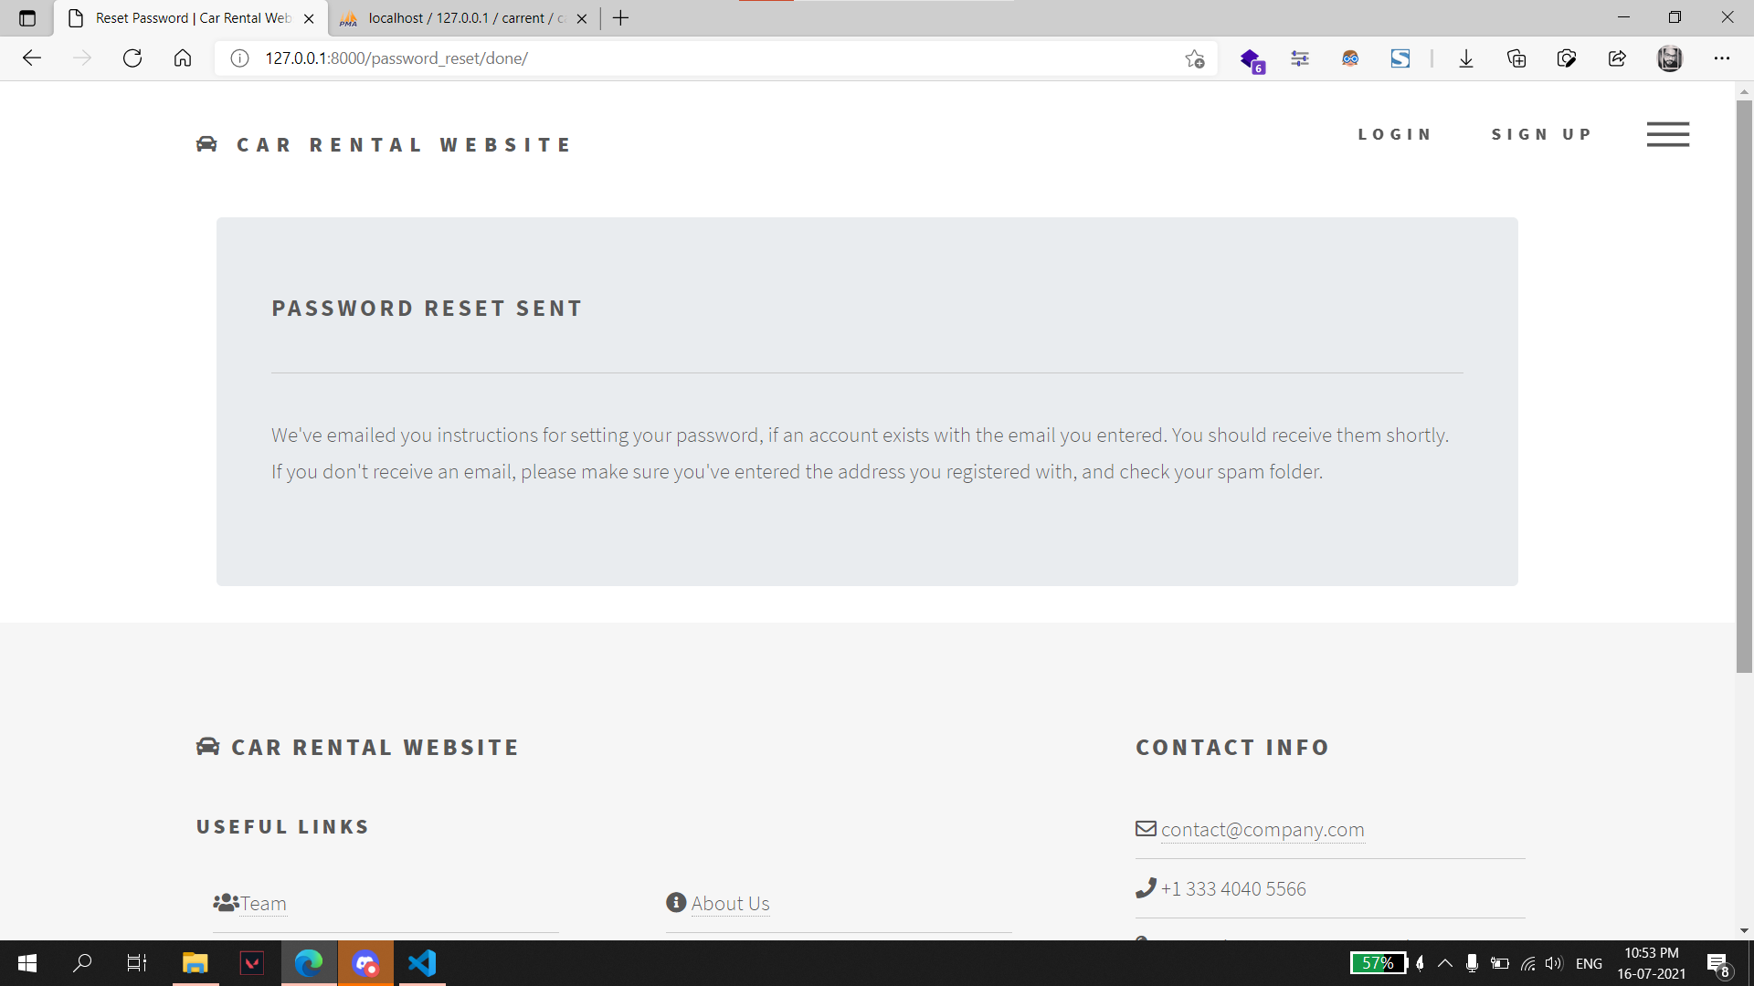
2. An email with link to reset password is sent to the submitted email address.

Slide 58
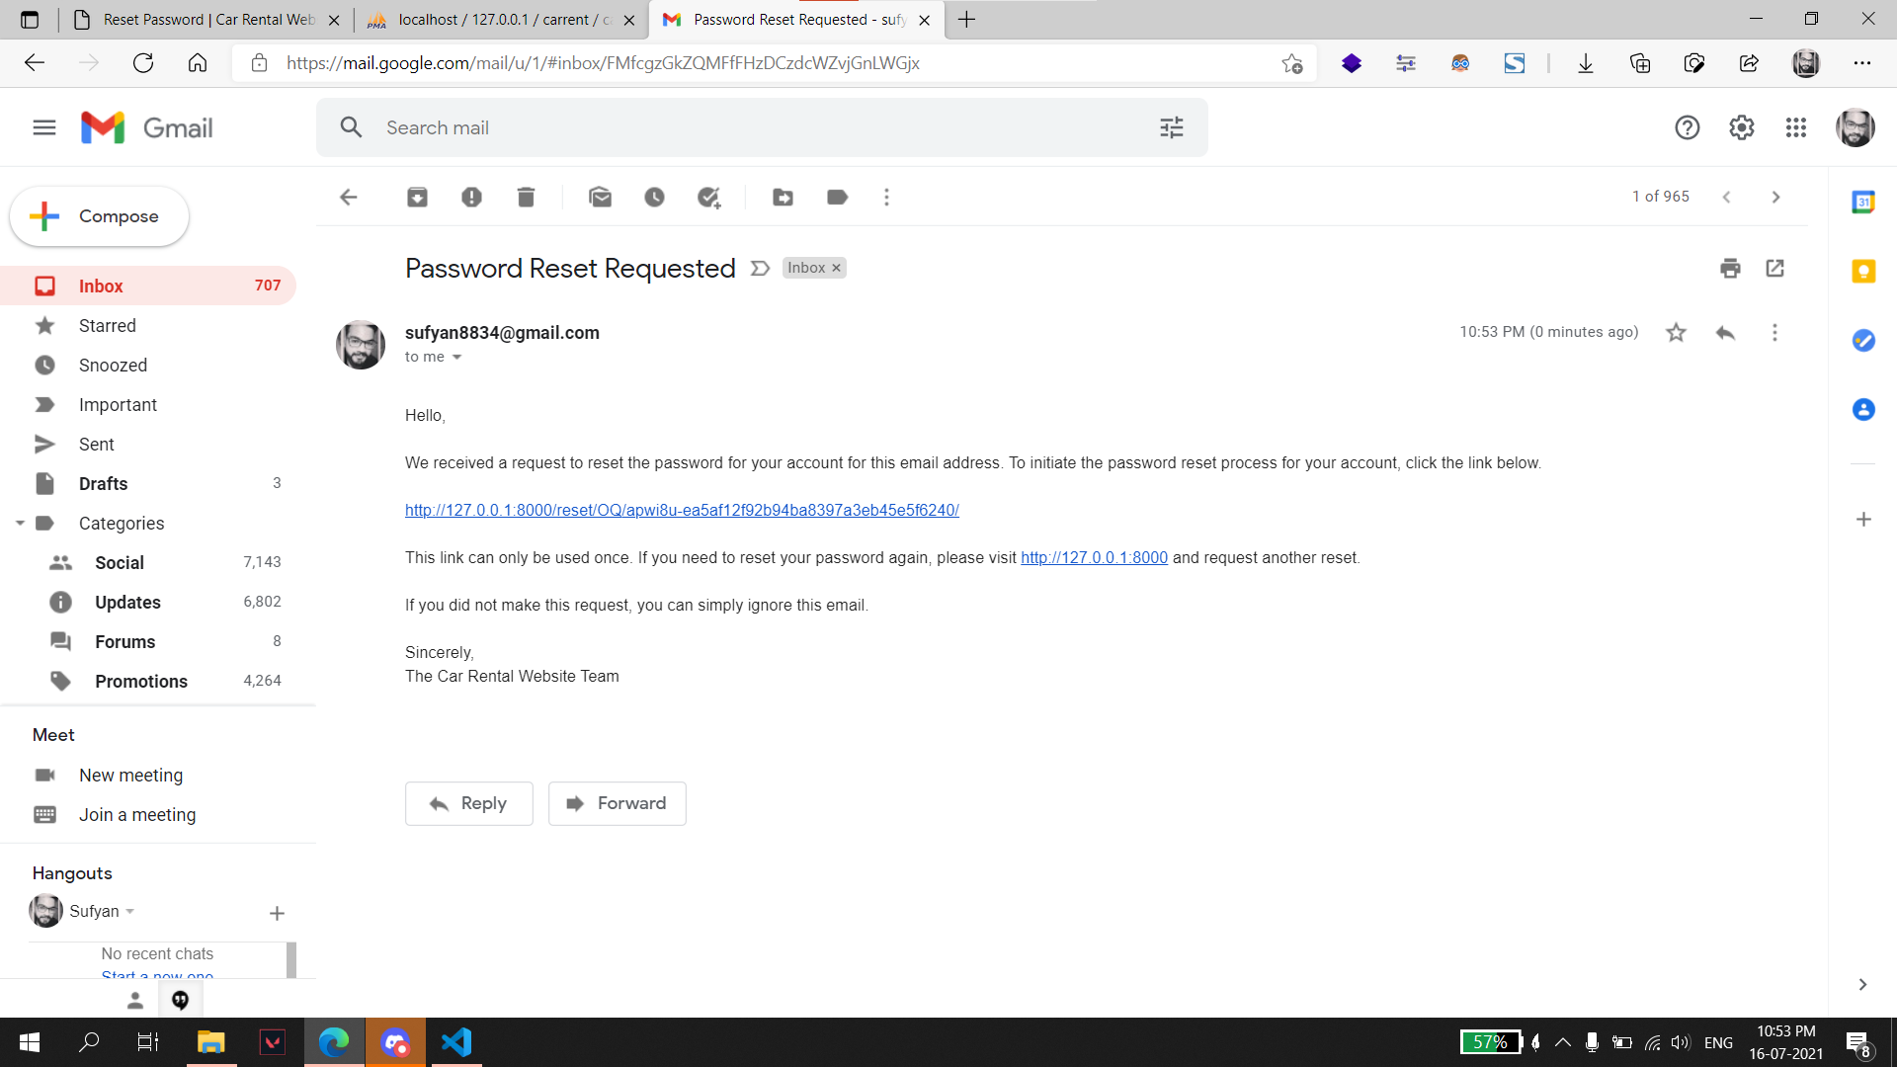
Email:

Slide 59
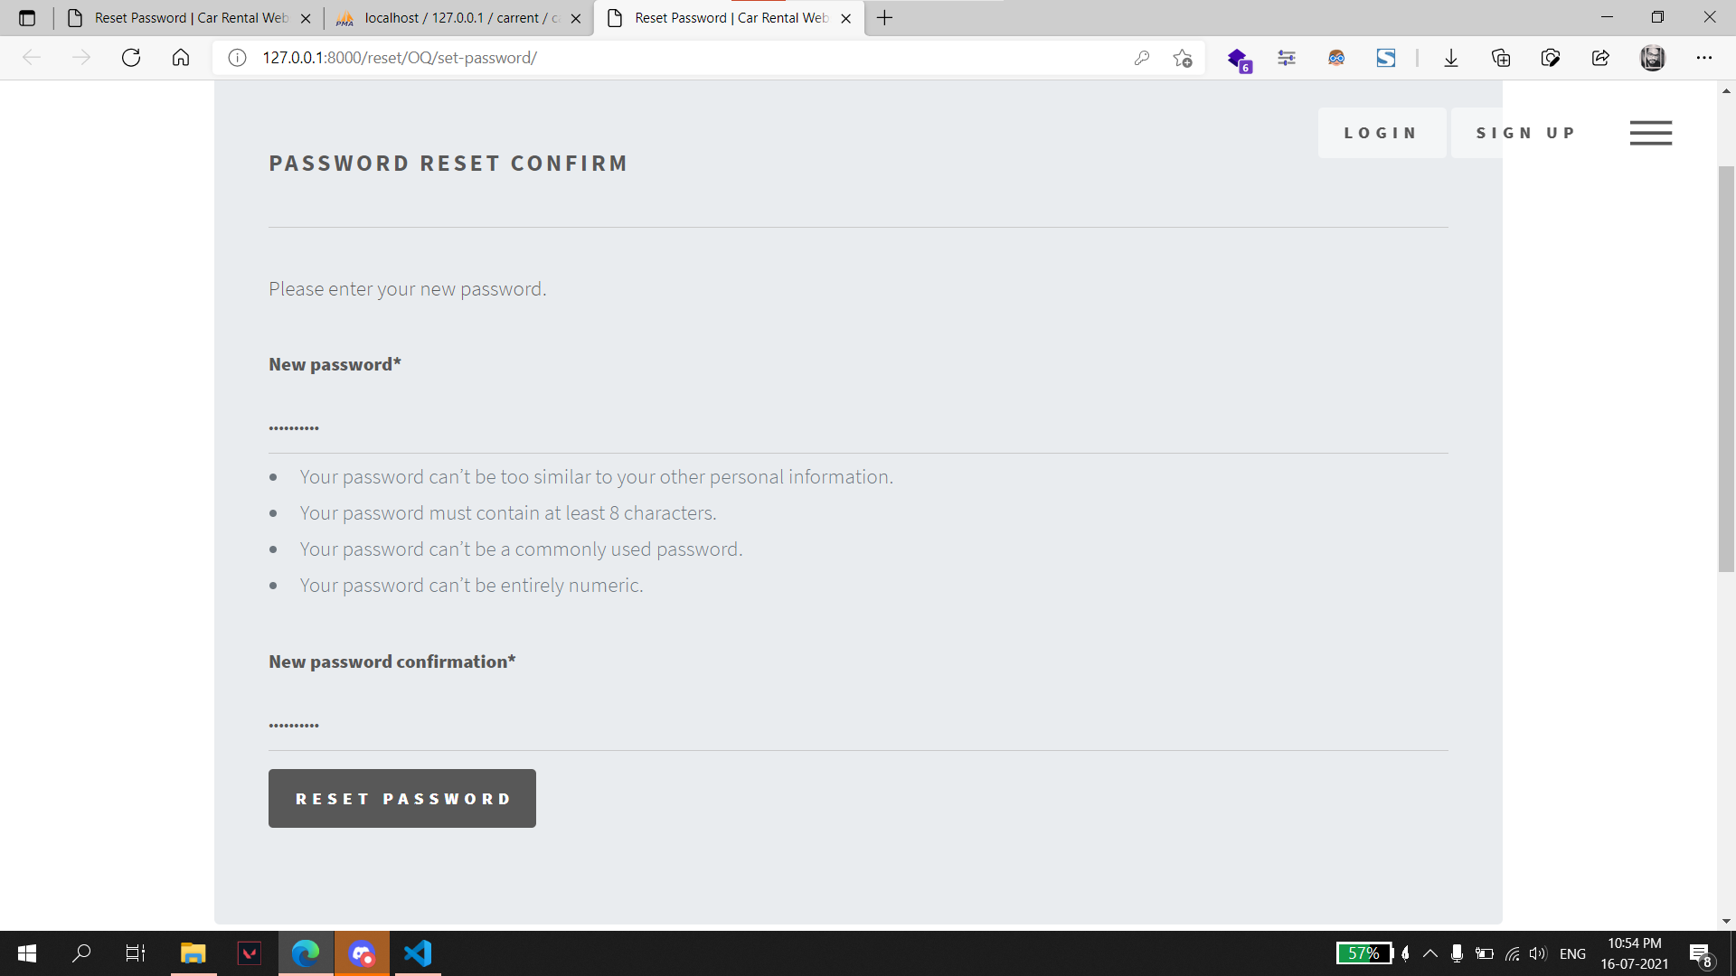
3. User enter new password.

Slide 60
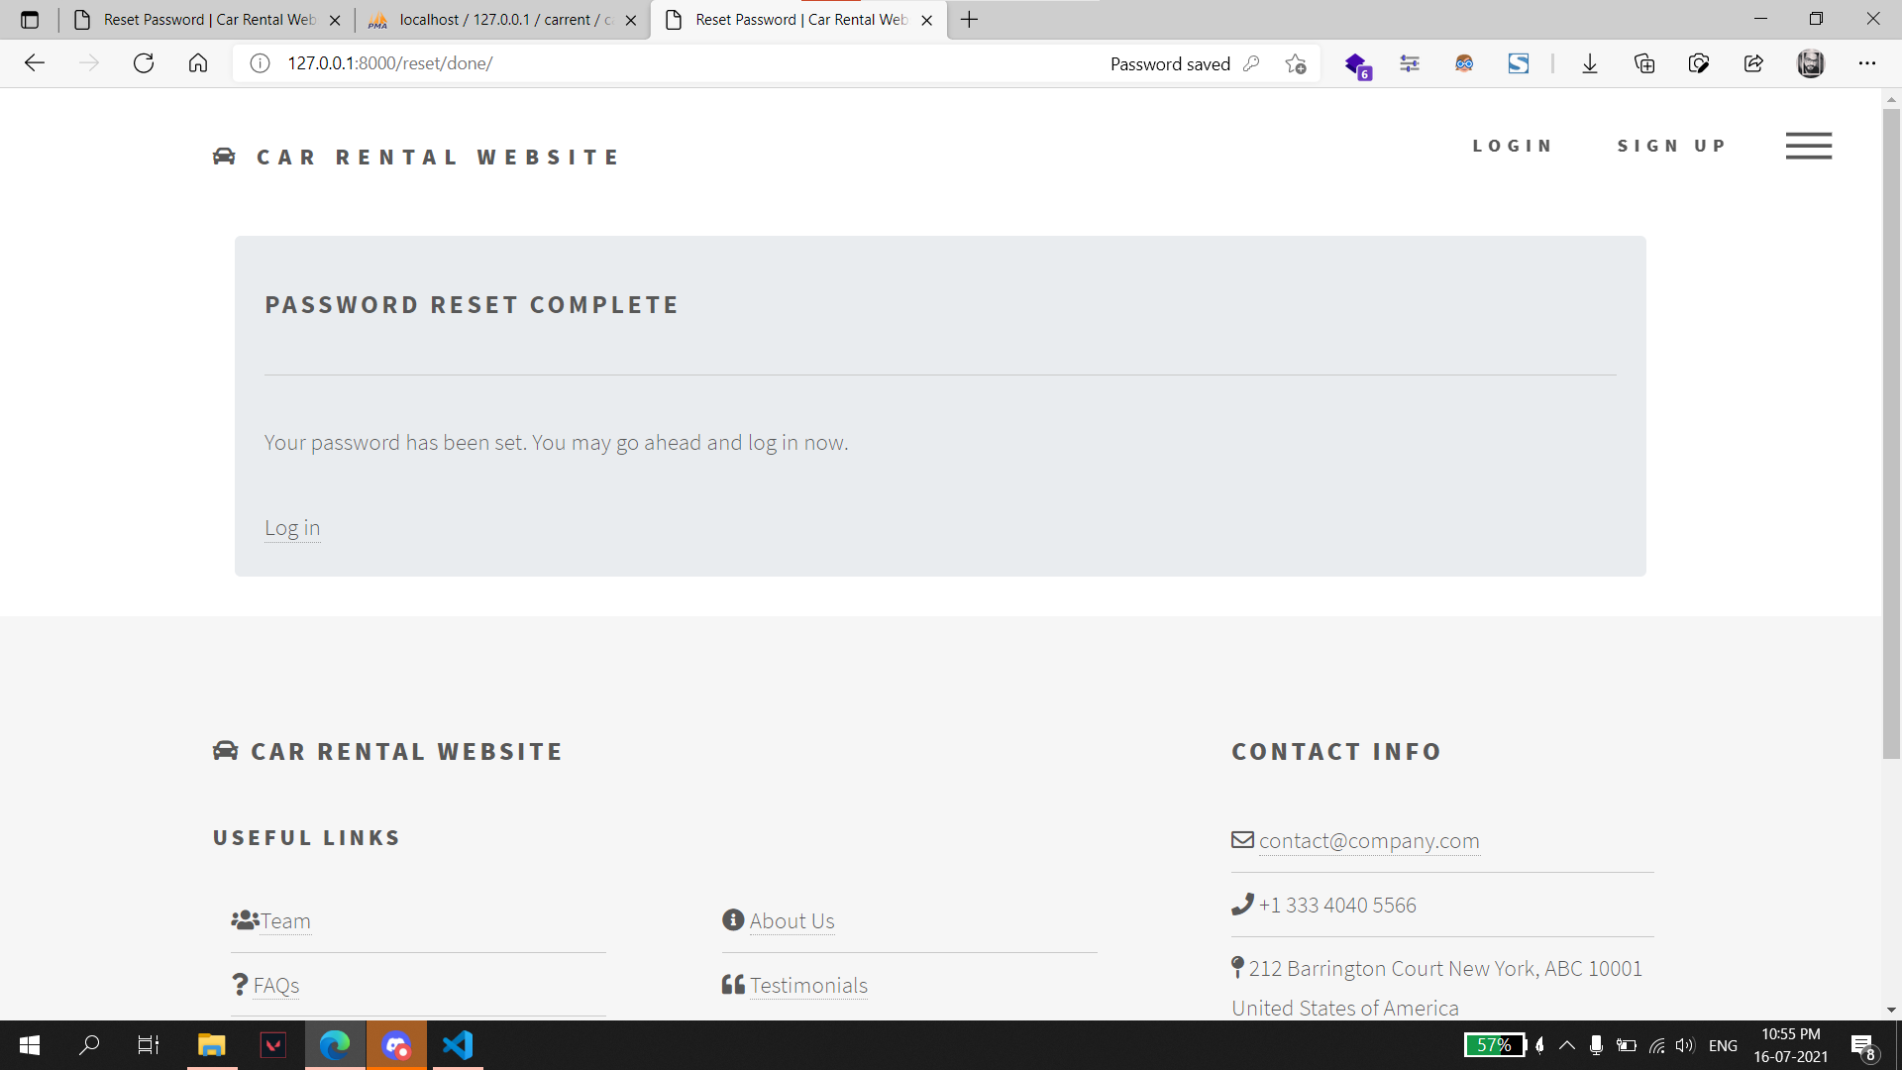
4. This page is displayed on resetting the password successfully.

Slide 61
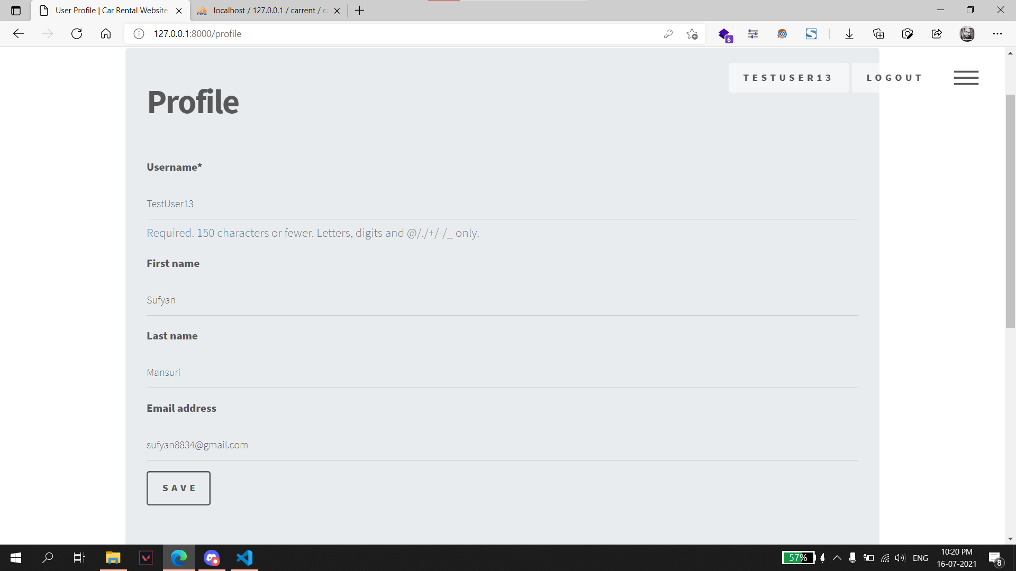
Profile: User can update profile details on this page.

Slide 62
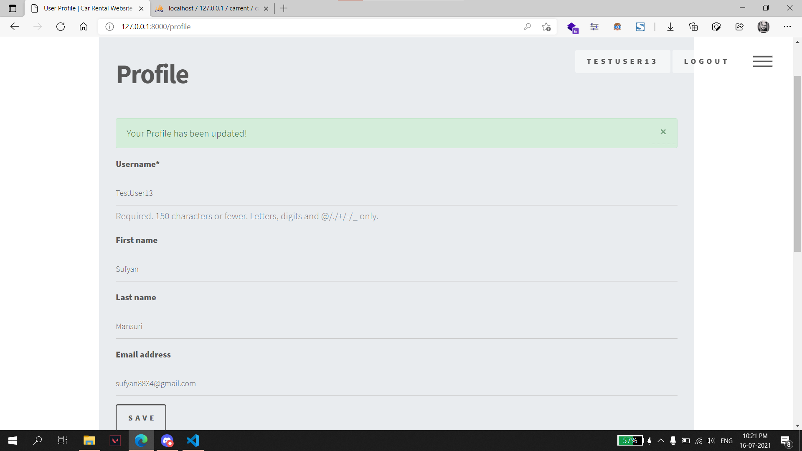
Update Profile: After updating profile.

Slide 63
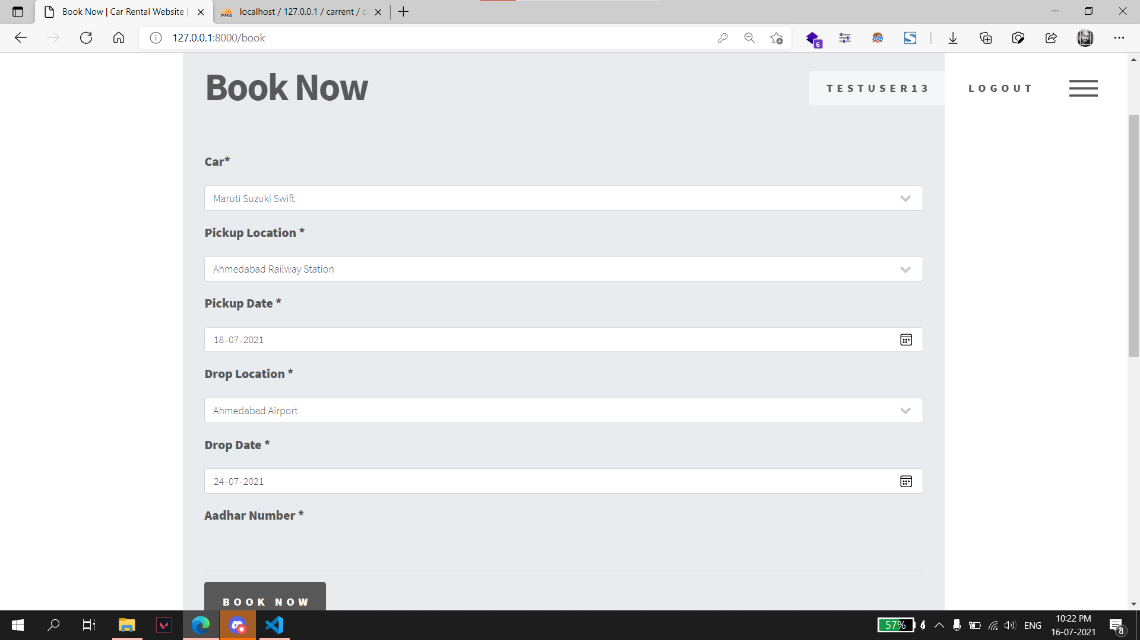
Booking: User can book a car for rent using this page.

Slide 64
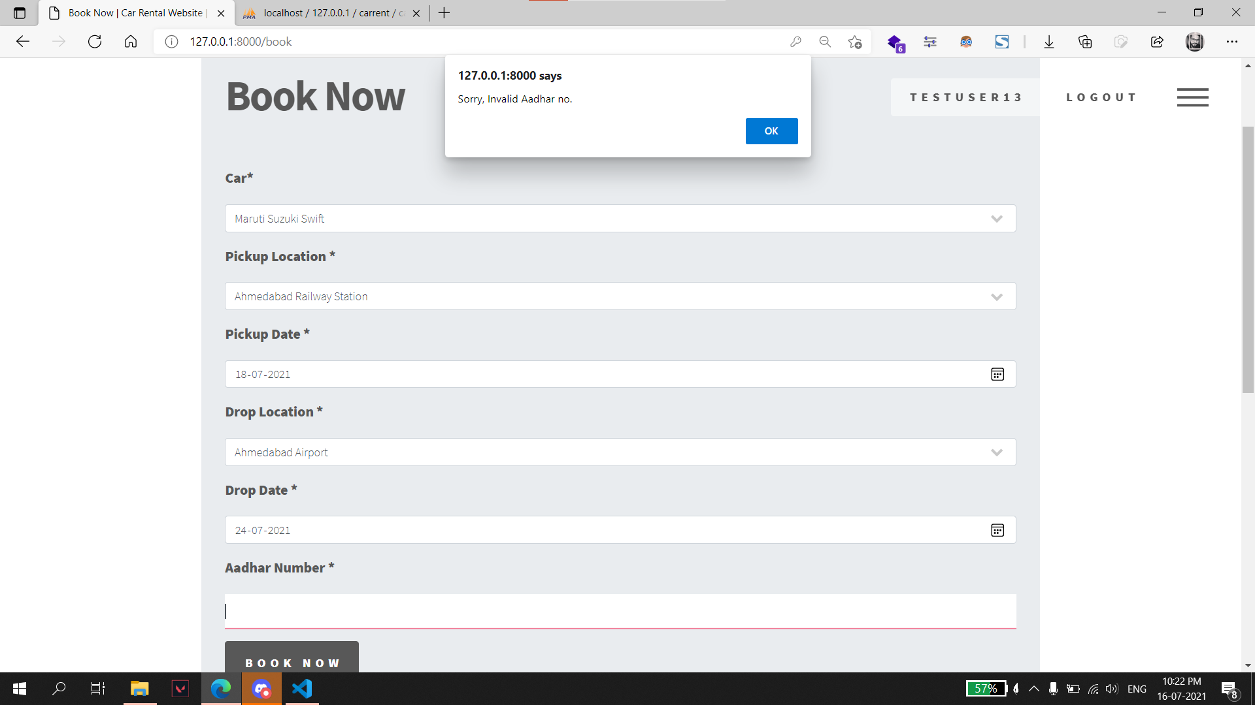
Booking: Aadhar number validation.

Slide 65
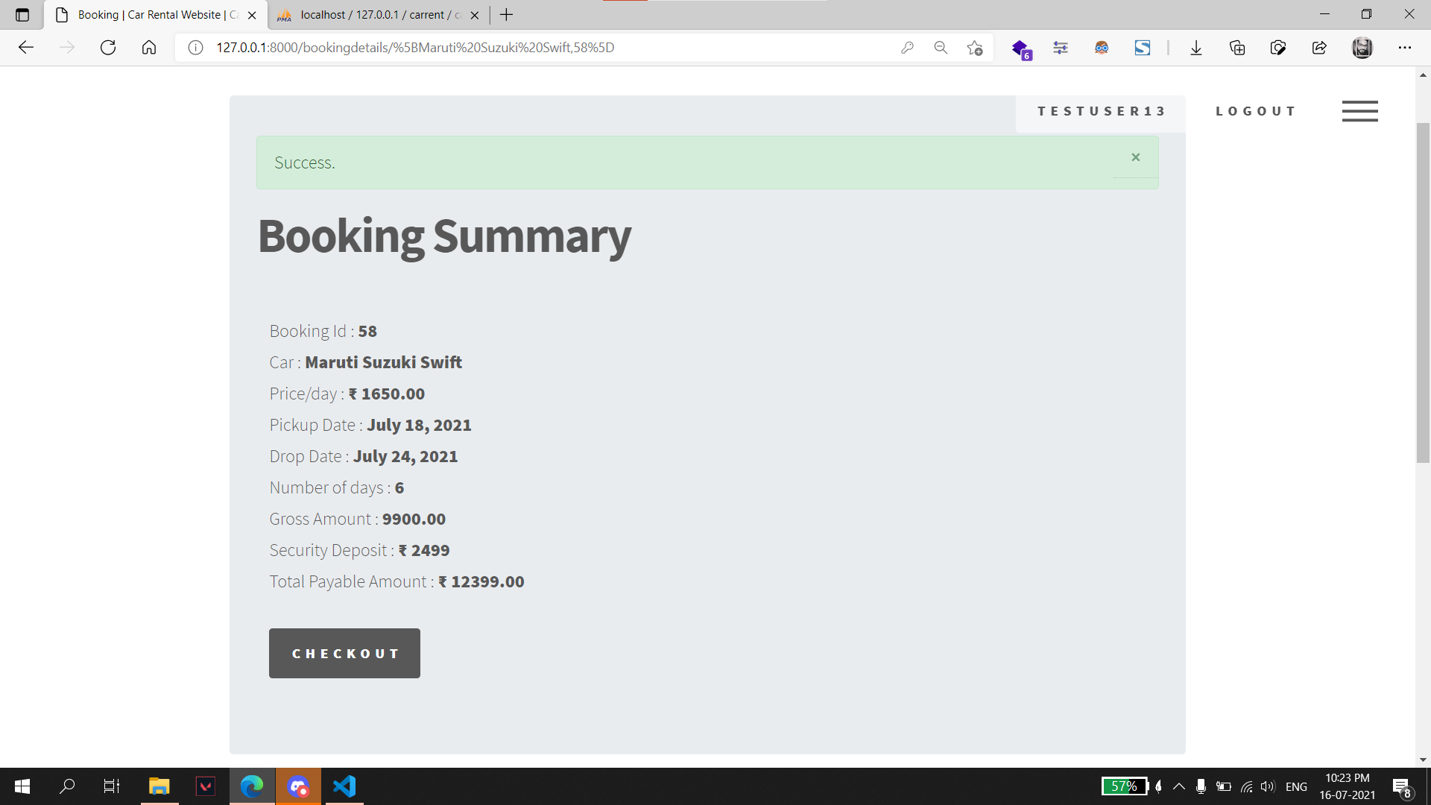
Book Summary: User is redirected to this page on successful submission of booking form.

Slide 66
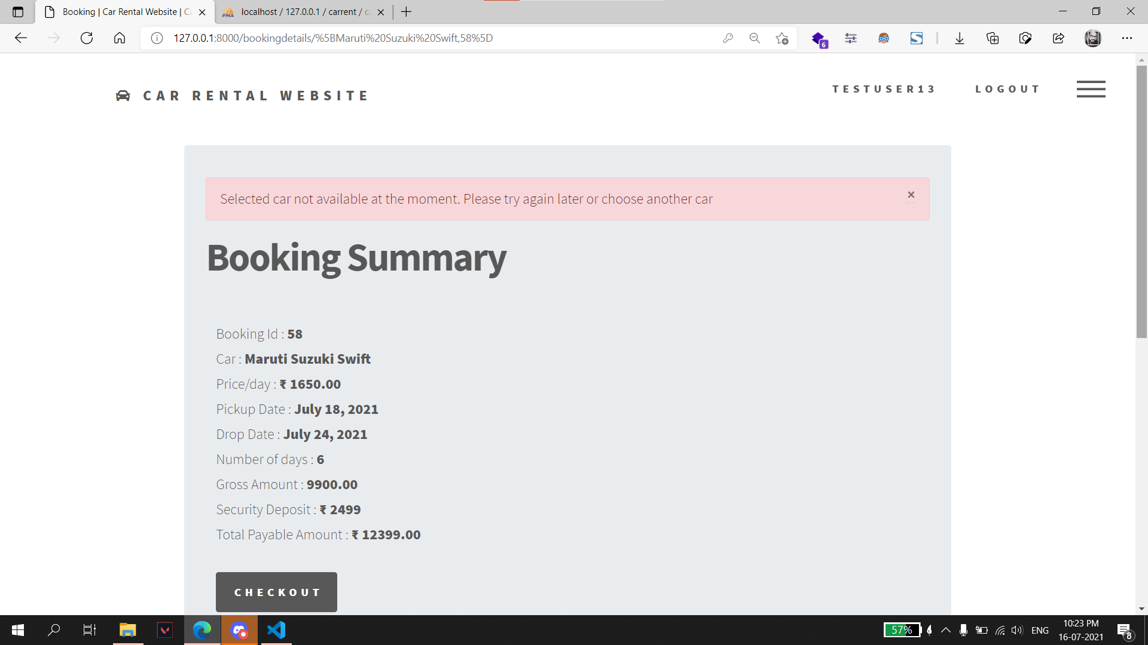
An error message is displayed on the page if selected car is not available for booking.

Slide 67
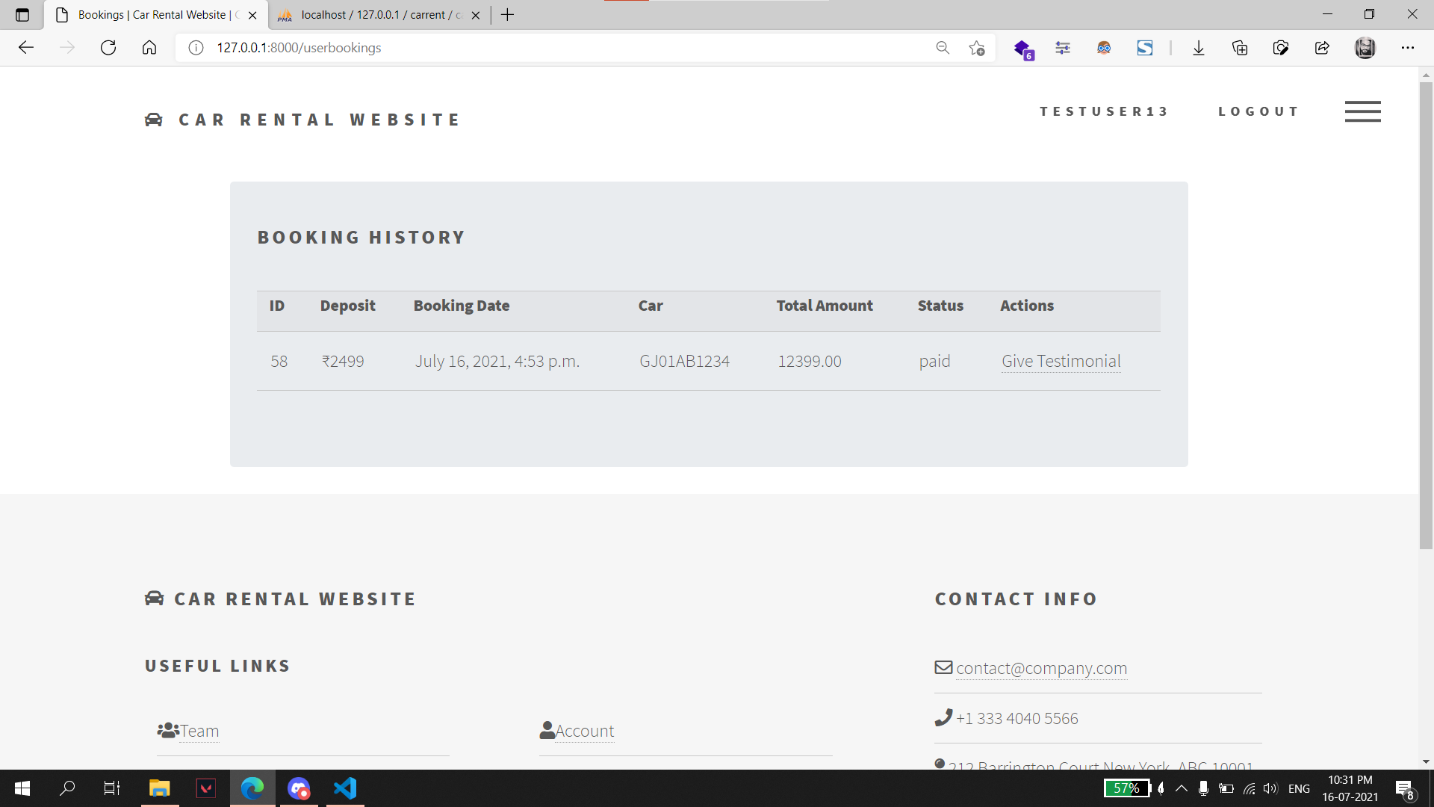
Booking History: User is redirected to “Booking History” page after checkout.

Slide 68
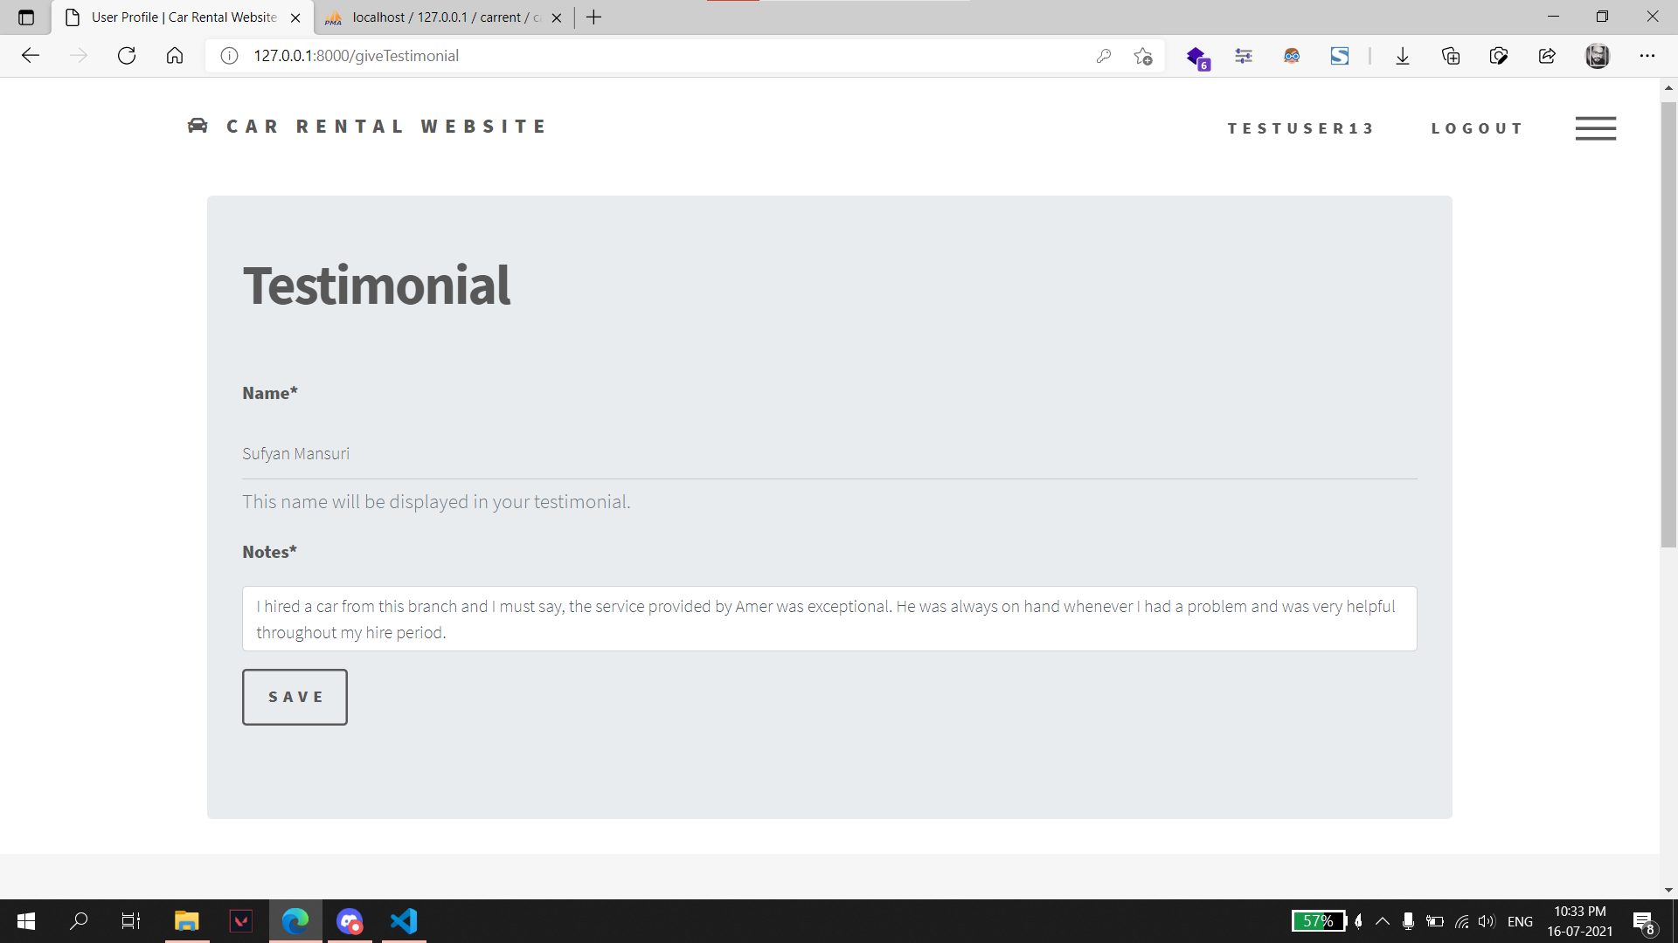
Give Testimonial: Customer can choose to give testimonial from this page.

Slide 69
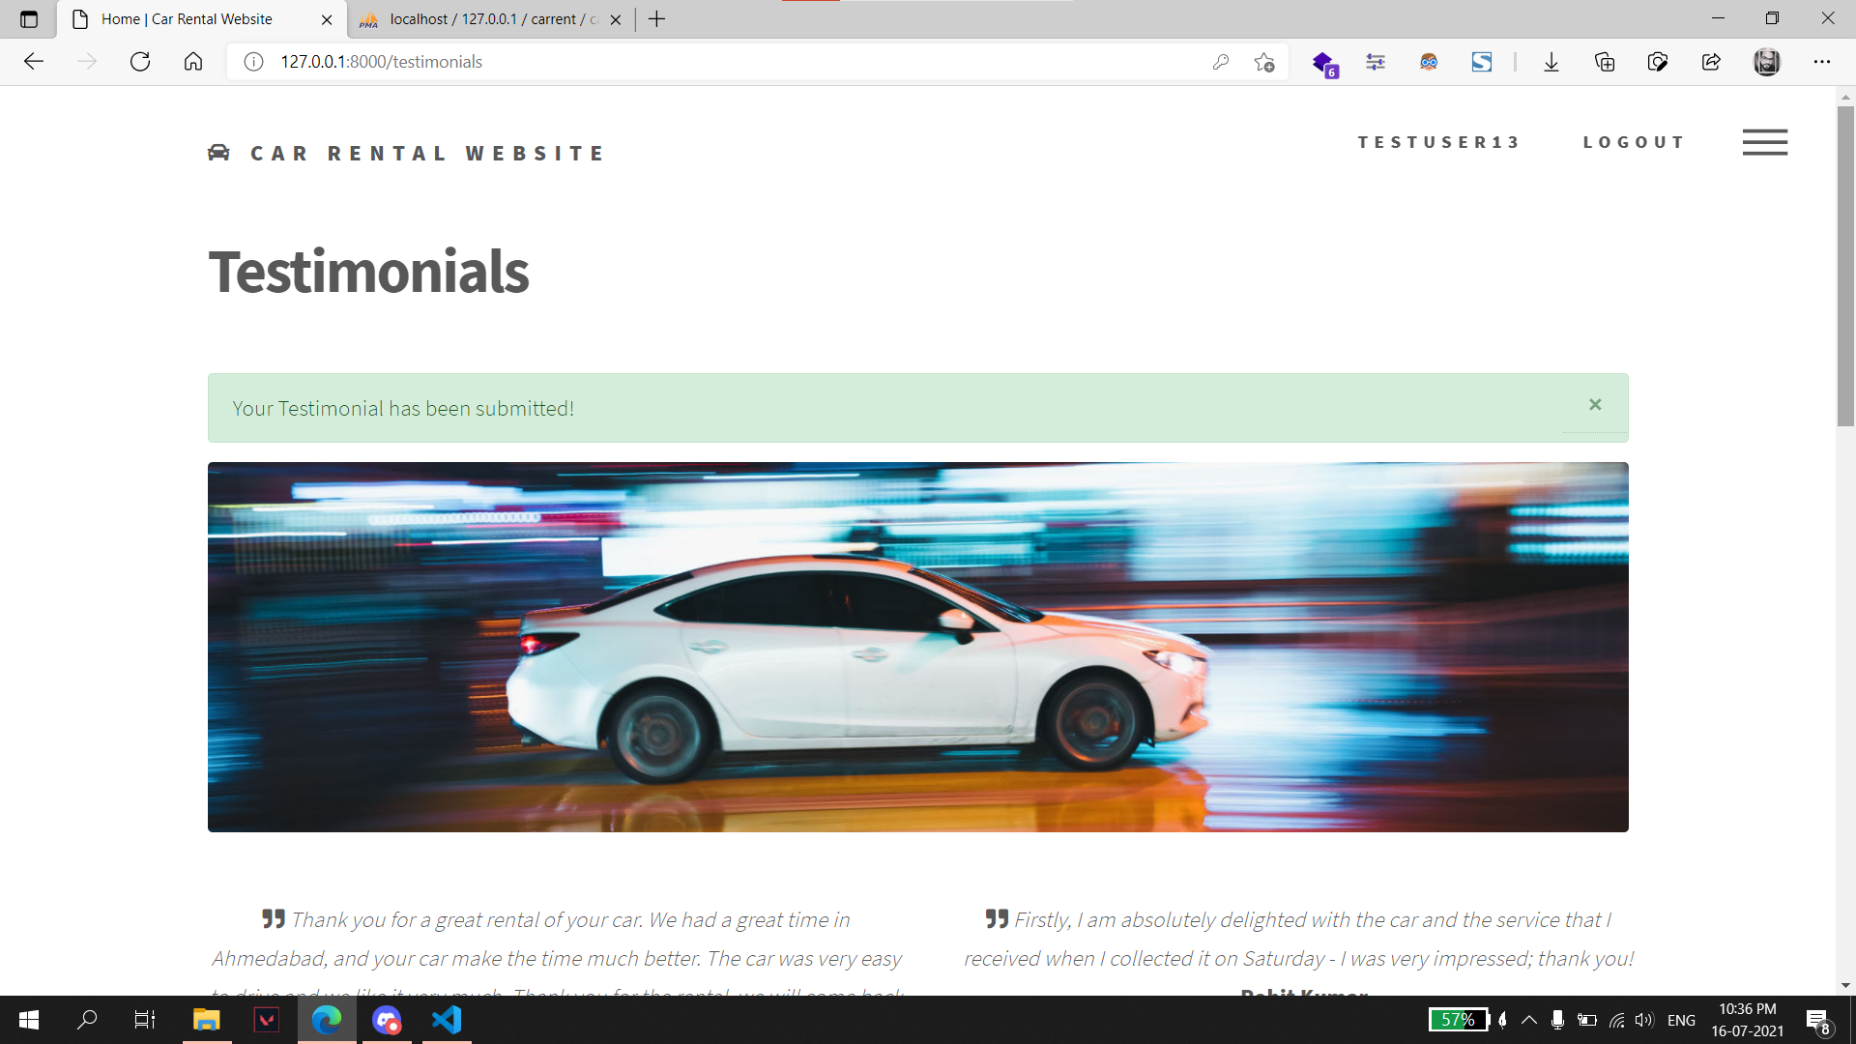
On successful submission of the form customer’s testimonial is added on “Testimonials” page with a success message.

Slide 70

Logout: A message is shown to the user on successful logout.

Slide 71
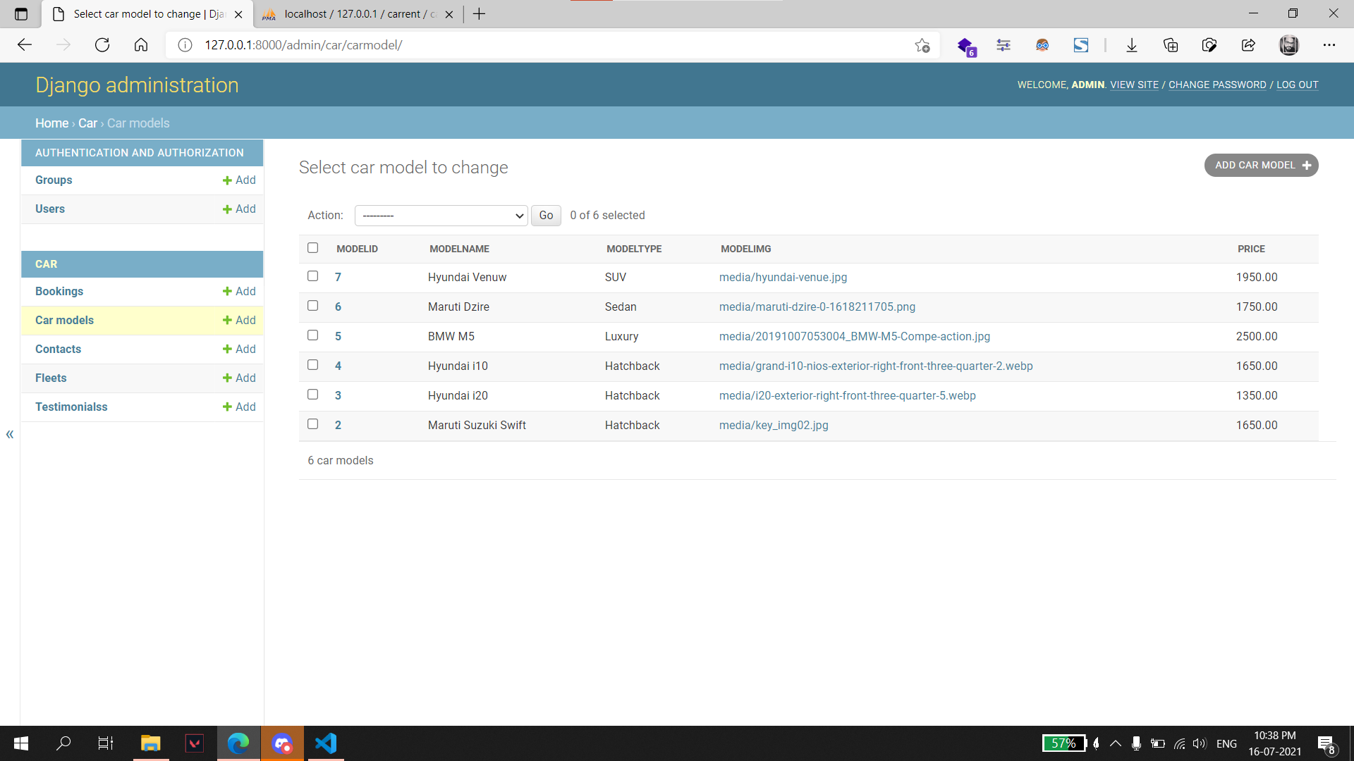
ADMIN SIDE
Car Model: Admin can add, edit or delete car models from this page.

Slide 72
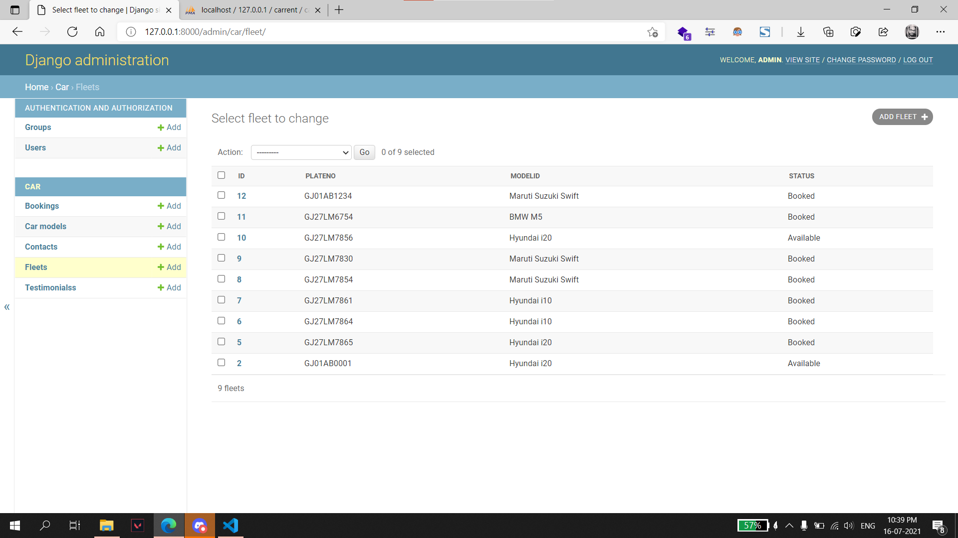
Fleet: Individual cars can be added, updated, or deleted from this page.

Slide 73
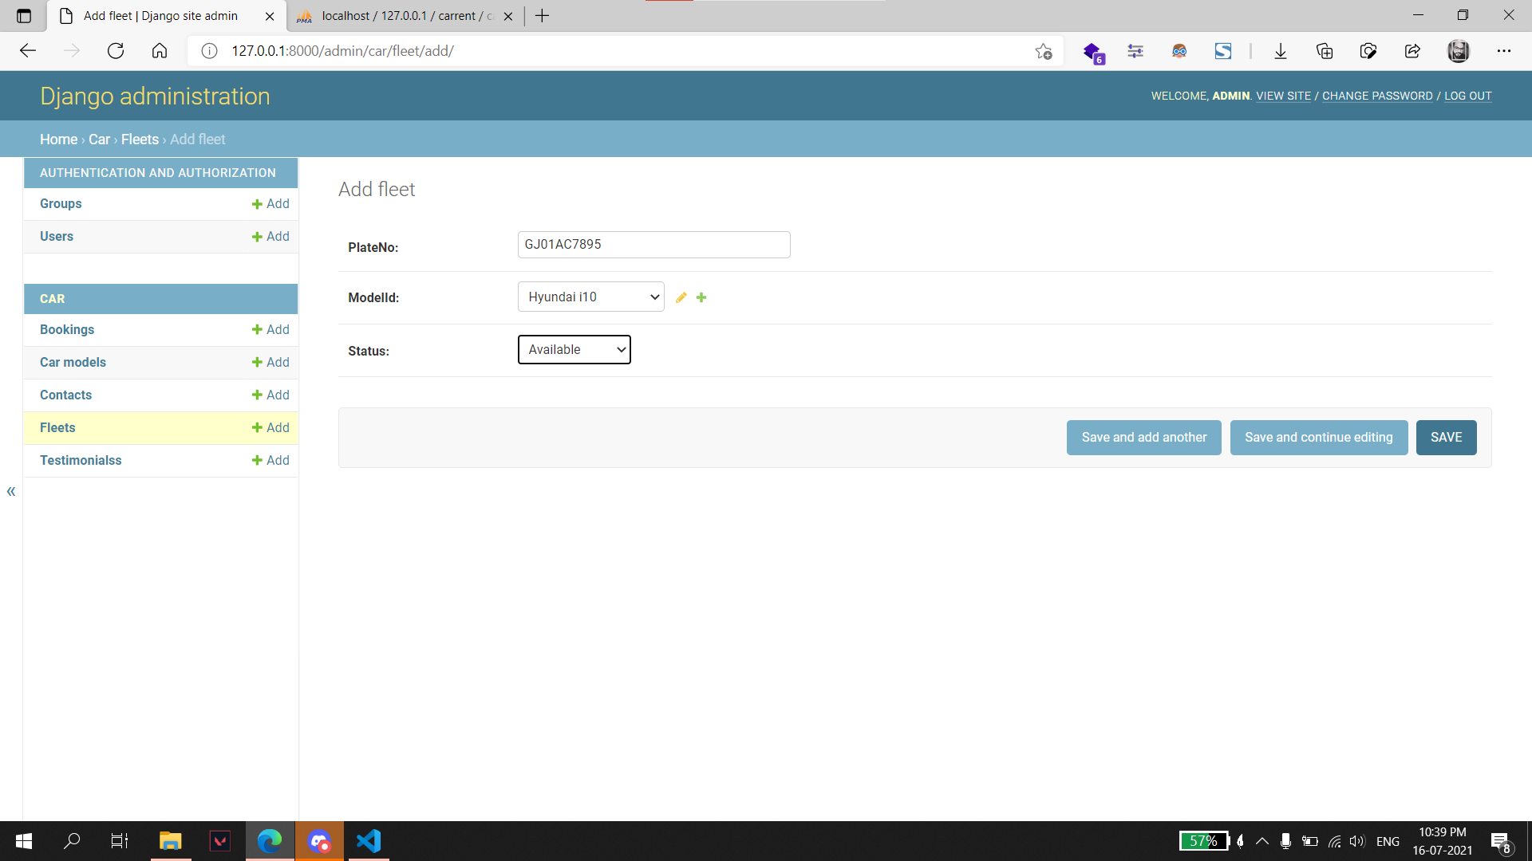

Slide 74
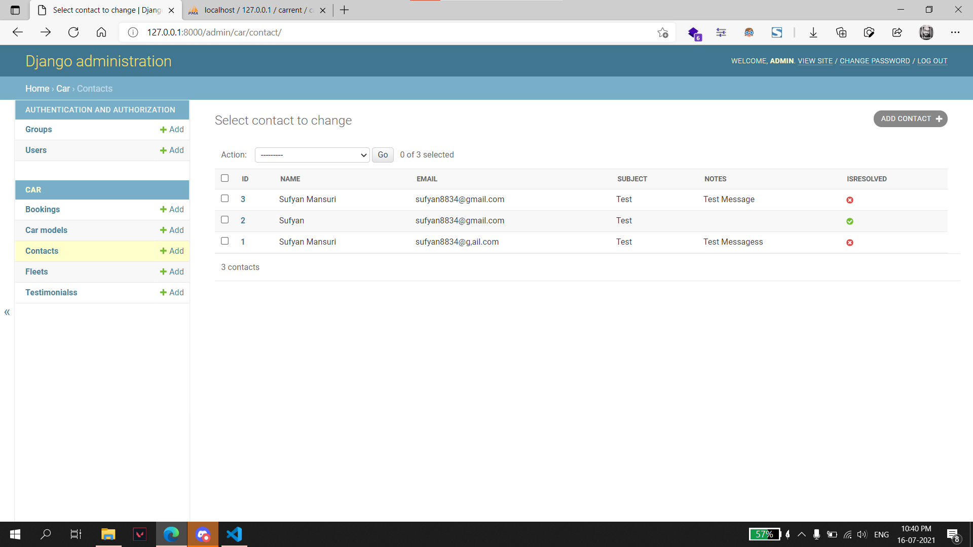
Queries from contacts page: Admin can update status of queries from this page.

Slide 75
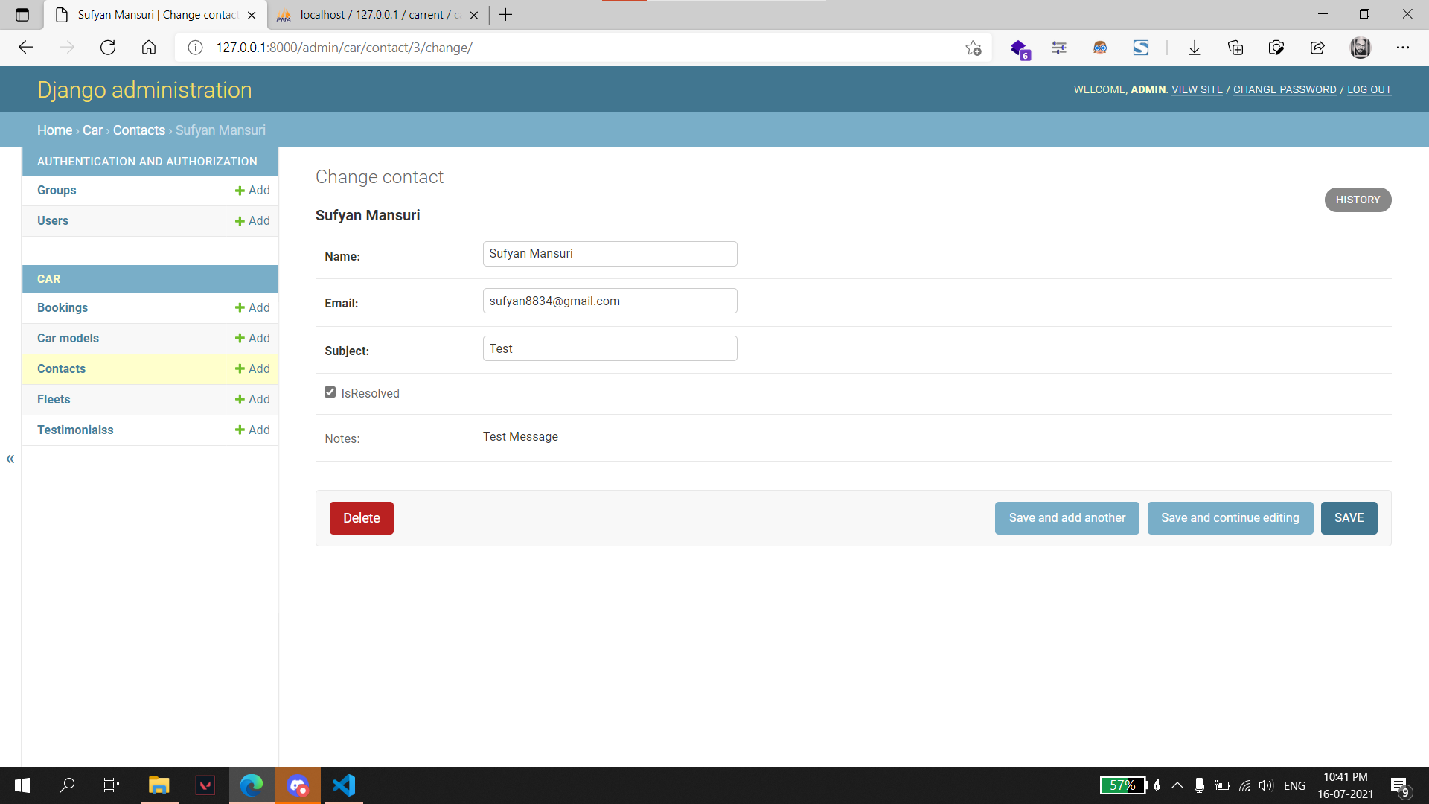

Slide 76
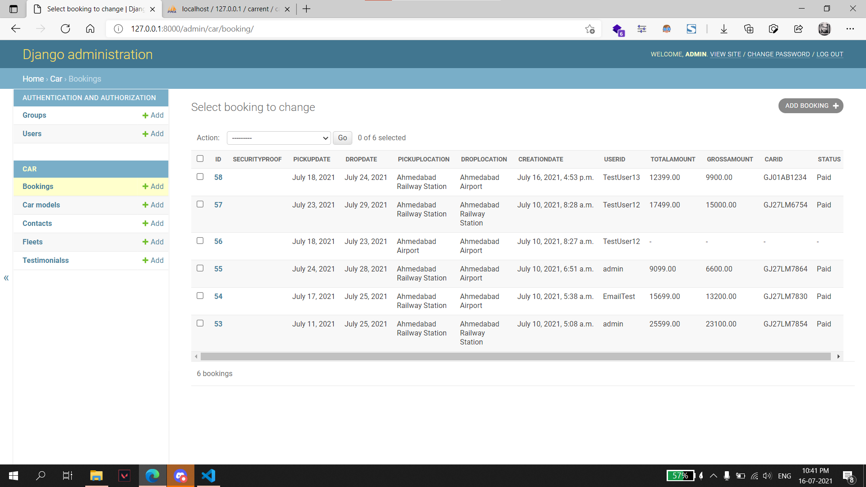
Bookings: Bookings can managed from this page.

Slide 77


Slide 78

Testimonials: Admin can manage testimonials from this page.

Slide 79


Slide 80
Proposed Enhancements
Integrate payment gateway.
Add functionality to manage bookings for customer.
We are planning to add a new feature i.e., pay after the trip.
We are working to increase automation in the system to increase user experience greatly.
Add functionality to generate reports.

Slide 81
conclusion
The web-based car rental system has offered an advantage to both customers as well as Car Rental Company to efficiently and effectively manage the business and satisfies customers’ need at the click of a button.
This project wanted to give customers and company an online platform, and it has given that platform using Django framework where customers can book car and company can approach the booking and respond accordingly.

Slide 82
Bibliography:
Django Documentation
https://docs.djangoproject.com/en/3.2/
YouTube
https://www.youtube.com
Visual Studio Code
https://code.visualstudio.com
Visual Paradigm
https://visual-paradigm.com
GitHub
https://github.com
Stack Overflow
https://stackoverflow.com
XAMPP Server
https://www.apachefriends.org/download.html

Slide 83
Thankyou

